Slide 1

High-Throughput Open Source Viterbi Decoder for OpenWiFi
Promotor: Josep Balasch (KU Leuven)
Co-promotor: Xianjun Jiao (imec, Ghent)
Students: Baiming Zhang, Yingshuo Xi

Slide 2
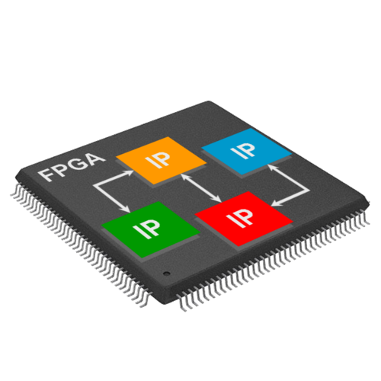


Small Tests about WiFi
start
Buy expensive IPs
Start from scratch

Slide 3
Overview
Introduction
Literature review
Implementation
Results
Discussion
Conclusions

Slide 4
Introduction
Topic
Aims
Importance
Objectives
Requirements

Slide 5



Topic
Wi-Fi chip
OpenWiFi
IEEE802.11a/g/n standard
Open source
Additional free options
More efficient

Slide 6

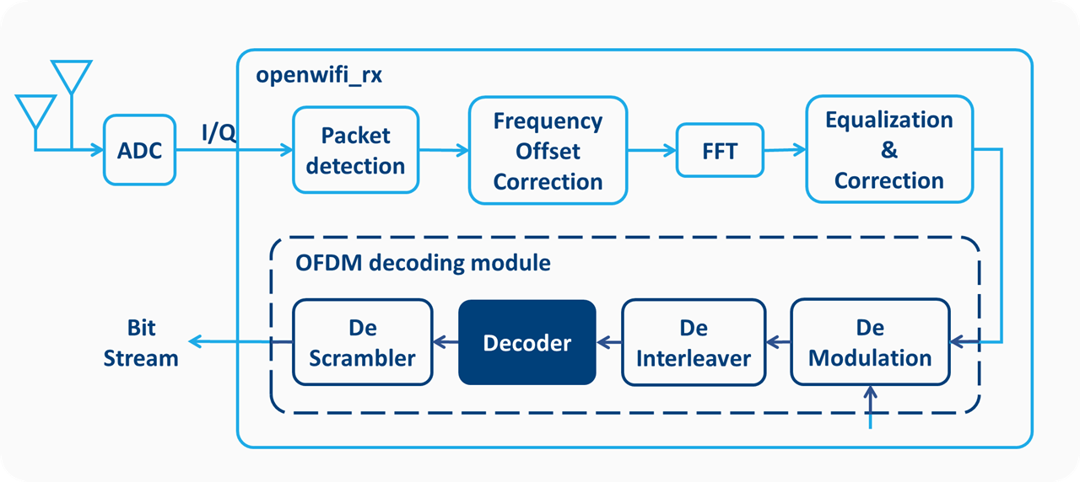
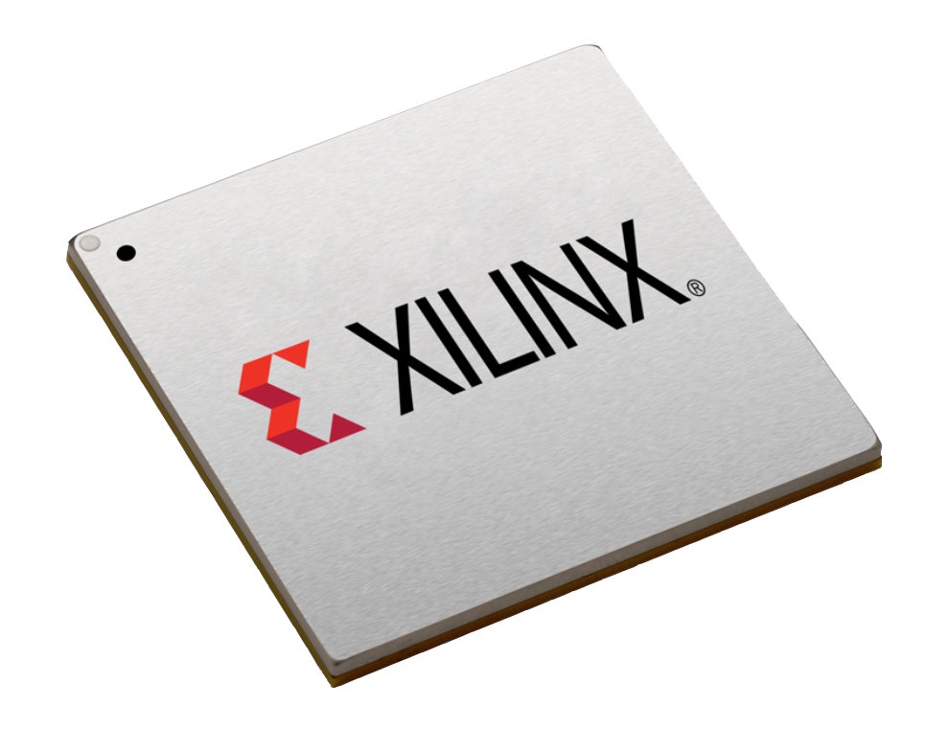

Topic
Xilinx’s decoder license
Stops every 1-2 hours
Unconvinient for testing
OpenWiFi’s OFDM Receiver Module

Slide 7


Aims
OpenWiFi’s OFDM Receiver Module

Slide 8
Aims
OpenWiFi’s OFDM Receiver Module

Slide 9
Aims
OpenWiFi’s OFDM Receiver Module

Slide 10
Aims
OpenWiFi’s OFDM Receiver Module

Slide 11
Aims
OpenWiFi’s OFDM Receiver Module

Slide 12
Aims
OpenWiFi’s OFDM Receiver Module

Slide 13


Importance
Address the Xilinx license limitations
Totally open source hardware design

Slide 14
Importance
Address the Xilinx license limitations
Totally open source hardware design

Slide 15
Objectives
Summarize the performance and functional requirements
Select the open source Viterbi decoder (trade-off)
Test the performance through simulation and synthesis.
Compare the ported decoder with the Xilinx one.
Examine the compatibility with the rest of OpenWiFi in simulation
Verify the functionality of the modified OpenWiFi on an FPGA board.

Slide 16
Requirements
Requirements |  | Requirements
Settings | Settings | (2,1,7) decoder with polynomials [171 133]
Function |  | Soft decision
 |  | De-puncturing
Performance | Processing Delay | ≤10𝜇𝑠
 | Throughput | ≥72.2Mbps
 | Power | Have comparable performance with the Xilinx one
 | Area | The area spanned by the decoder circuit
 | Noise Resilience | Error correction capability

Slide 17
Literature review
Background
Convolutional encoder
Viterbi Algorithm
Viterbi decoder structure
Different theories
Branch Metric Unit: Hamming, Euclidean & Linear distance
Add-Compare-Select Unit
Survivor Management Unit: Register Exchange & Traceback
Open source Searching

Slide 18
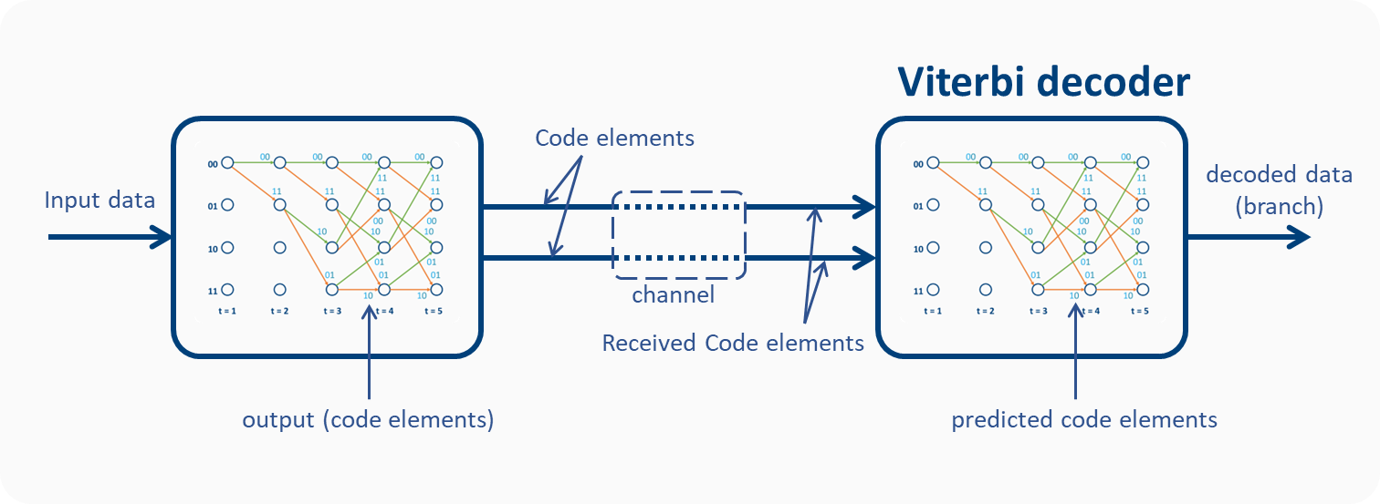
WiFi system
Convolutional encoder
Analog

Slide 19
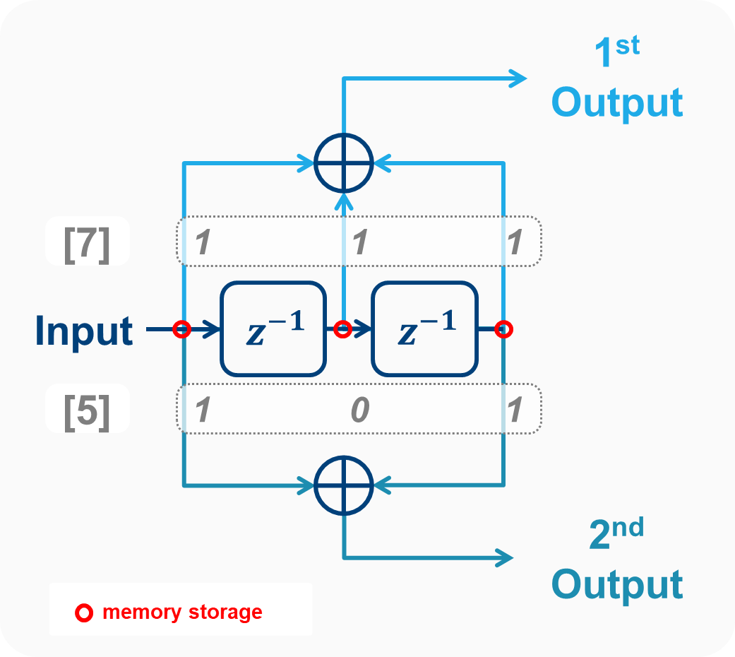
Convolutional encoder
(2 ,1, 3) encoder
Constraint length
Number of input bits
Number of output bits

Slide 21
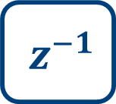
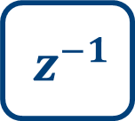
1st Output
[7]
1
1
1
$$z^{−1}$$
$$z^{−1}$$
Input
[5]
1
0
1
2nd Output
memory storage

Slide 22


1
1
0
0
0
1
1
1
0
1
0
0
0
0
$$z^{−1}$$
$$z^{−1}$$
0
1

Slide 23
1
1
0
1
0
0
1
1
1
0
0
1
0
0
$$z^{−1}$$
$$z^{−1}$$
0
0
1

Slide 24
1
1
0
1
0
1
0
1
1
1
1
0
1
1
$$z^{−1}$$
$$z^{−1}$$
0
0
0
1

Slide 25
0
1
1
0
1
1
0
0
1
1
1
1
0
0
$$z^{−1}$$
$$z^{−1}$$
0
1
0
0
1

Slide 26
0
0
1
1
1
1
1
1
0
1
1
1
1
1
$$z^{−1}$$
$$z^{−1}$$
0
0
1
0
0
1

Slide 27
1
0
0
1
1
0
0
1
1
0
0
1
1
1
$$z^{−1}$$
$$z^{−1}$$
1
1
0
1
0
0
1

Slide 28
Convolutional encoder
0
1
0
0
1
1
Data
0
0
1
1
0
1
Last
First
0
$$z^{−1}$$
1
$$z^{−1}$$
1
Coded
1
1
0
1
0
0
1
0
0
1
1
0
1
0
1
0
0
1

Slide 29
Requirements
Requirements |  | Requirements
Settings | Settings | (2,1,7) decoder with polynomials [171 133]
Function |  | Soft decision
 |  | De-puncturing
Performance | Processing Delay | ≤10𝜇𝑠
 | Throughput | ≥72.2Mbps
 | Power | Have comparable performance with the Xilinx one
 | Area | The area spanned by the decoder circuit
 | Noise Resilience | Error correction capability

Slide 30
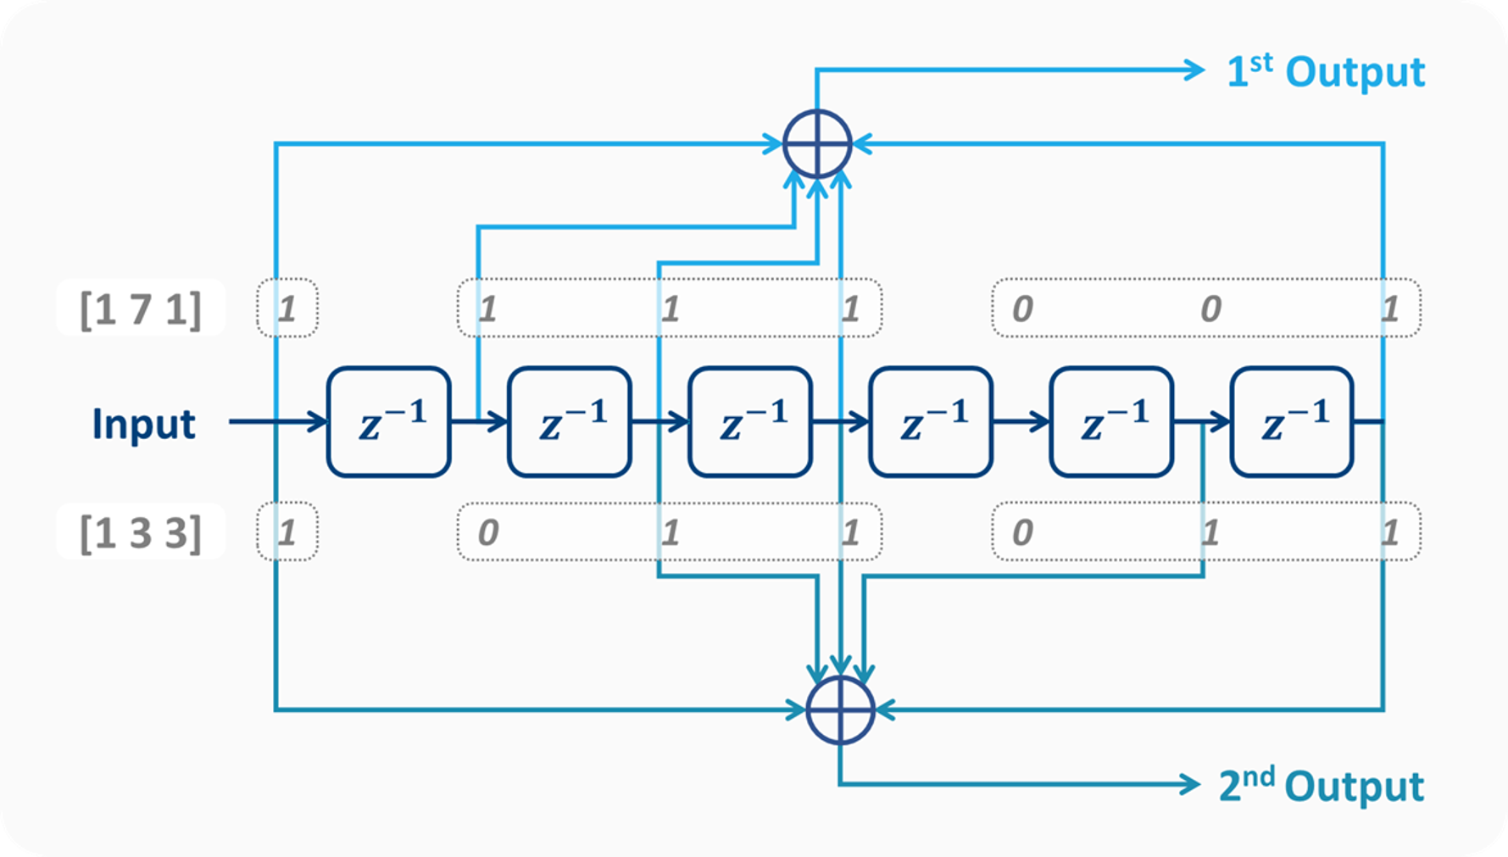
WiFi Convolutional encoder
(2,1,7) encoder with polynomials [171 133]

Slide 31
Literature review
Background
Convolutional encoder
Viterbi Algorithm
Viterbi decoder structure
Different theories
Branch Metric Unit: Hamming, Euclidean & Linear distance
Add-Compare-Select Unit
Survivor Management Unit: Register Exchange & Traceback
Open source Searching

Slide 32
Viterbi algorithm
Convolutional encoder
Compare all the possible transmission paths
Select the most likely sequence

Slide 33
Viterbi Algorithm
Add to PMs
Update survivor paths
Calculate BMs
Convolutional encoder
BM: difference
Branching Metric (BM): how much the received code elements differ from the predicted code elements.
Path metric (PM): the sum of all previous BMs.
Survivor path: The path with the lowest PM for one node.

Slide 34
Viterbi Algorithm Working
00
PM1
01
PM2
10
PM3
11
PM4
t = 1

Slide 35
Initialization
00
PM1
=
0
01
PM2
=
0
10
PM3
=
0
11
PM4
=
0
t = 1

Slide 36
Calculate BMs
BM
00
PM1
=
0
01
PM2
=
0
10
PM3
=
0
11
PM4
=
0
t = 1
t = 2

Slide 37
Calculate BMs
BM
2
00
PM1
=
0
0
01
PM2
=
0
10
PM3
=
0
11
PM4
=
0
t = 1
t = 2

Slide 38
Add to PMs
BM
2
00
PM1
=
2
0
01
PM2
=
0
10
PM3
=
0
11
PM4
=
0
t = 1
t = 2

Slide 39
Calculate BMs
BM
2
00
PM1
=
2
0
01
PM2
=
0
10
PM3
=
0
11
PM4
=
0
t = 1
t = 2
t = 3

Slide 40
Calculate BMs
BM
2
1
00
PM1
=
2
0
1
01
PM2
=
0
2
10
PM3
=
0
0
11
PM4
=
0
t = 1
t = 2
t = 3

Slide 41
Add to PMs
BM
2
1
00
PM1
=
3
0
1
01
PM2
=
3
2
10
PM3
=
2
0
11
PM4
=
0
t = 1
t = 2
t = 3

Slide 42
Calculate BMs
BM
2
1
00
=
PM1
3
0
1
01
=
PM2
3
2
10
=
PM3
2
0
11
=
PM4
0
t = 1
t = 2
t = 3
t = 4

Slide 43
Calculate BMs
BM
2
1
1
00
=
PM1
3
1
0
1
1
01
=
PM2
3
2
1
2
10
=
0
PM3
2
0
0
11
=
PM4
0
2
t = 1
t = 2
t = 3
t = 4

Slide 44
Add to PMs
BM
{
2
1
1
4
00
PM1
3
1
0
1
1
{
01
4
PM2
3
2
1
2
{
5
10
0
PM3
0
0
{
0
3
11
PM4
2
2
t = 1
t = 2
t = 3
t = 4

Slide 45
Update survivor paths
BM
00
=
PM1
3
1
0
01
=
PM2
3
2
1
10
=
0
PM3
0
0
11
=
PM4
2
2
t = 1
t = 2
t = 3
t = 4

Slide 46
Calculate BMs
BM
00
=
PM1
3
1
0
01
=
PM2
3
2
1
10
=
0
PM3
0
0
11
=
PM4
2
2
t = 1
t = 2
t = 3
t = 4
t = 5

Slide 47
Calculate BMs
BM
1
00
=
PM1
3
1
1
0
1
01
=
PM2
3
1
1
2
0
10
=
0
PM3
0
0
2
2
=
11
PM4
2
2
0
t = 1
t = 2
t = 3
t = 4
t = 5

Slide 48
Add to PMs
BM
1
{
00
4
PM1
1
1
1
0
1
{
01
4
PM2
1
1
2
1
0
{
3
10
0
PM3
4
0
2
2
{
5
11
PM4
2
0
2
t = 1
t = 2
t = 3
t = 4
t = 5

Slide 49
Update survivor paths
BM
00
=
PM1
1
1
0
01
=
PM2
1
1
1
2
0
10
=
0
PM3
3
0
11
=
PM4
2
2
0
t = 1
t = 2
t = 3
t = 4
t = 5

Slide 50
Calculate BMs
BM
00
=
PM1
1
1
0
01
=
PM2
1
1
1
2
0
10
=
0
PM3
3
0
=
11
PM4
2
2
0
t = 1
t = 2
t = 3
t = 4
t = 5
t = 6

Slide 51
Calculate BMs
BM
1
00
=
PM1
1
1
1
0
1
01
=
PM2
1
1
1
1
2
0
2
=
10
0
PM3
3
0
0
0
=
11
PM4
2
2
0
2
t = 1
t = 2
t = 3
t = 4
t = 5
t = 6

Slide 52
Add to PMs
BM
{
1
2
00
PM1
1
4
1
0
1
{
01
2
PM2
4
1
1
1
2
0
2
{
3
10
0
PM3
2
0
0
{
0
1
11
PM4
2
0
2
4
t = 1
t = 2
t = 3
t = 4
t = 5
t = 6

Slide 53
Update survivor paths
BM
1
00
=
PM1
2
1
0
1
01
=
PM2
2
1
=
10
0
PM3
2
0
0
0
=
11
PM4
1
2
0
t = 1
t = 2
t = 3
t = 4
t = 5
t = 6

Slide 54
Select final survivor path
BM
1
00
=
PM1
2
1
0
1
01
=
PM2
2
1
=
10
0
PM3
2
0
0
0
=
11
PM4
1
2
0
t = 1
t = 2
t = 3
t = 4
t = 5
t = 6

Slide 55
Select final survivor path
BM
1
00
=
PM1
2
1
0
1
01
=
PM2
2
1
=
10
0
PM3
2
0
0
0
=
11
PM4
1
2
0
t = 1
t = 2
t = 3
t = 4
t = 5
t = 6

Slide 56
00
01
10
11
t = 1
t = 2
t = 3
t = 4
t = 5
t = 6

Slide 57
00
01
10
11
t = 1
t = 2
t = 3
t = 4
t = 5
t = 6

Slide 58
00
01
10
11
t = 1
t = 2
t = 3
t = 4
t = 5
t = 6
Decoded sequence:
1
1
0
1
1

Slide 59
Literature review
Background
Convolutional encoder
Viterbi Algorithm
Viterbi decoder structure
Different theories
Branch Metric Unit: Hamming, Euclidean & Linear distance
Add-Compare-Select Unit
Survivor Management Unit: Register Exchange & Traceback
Open source Searching

Slide 60
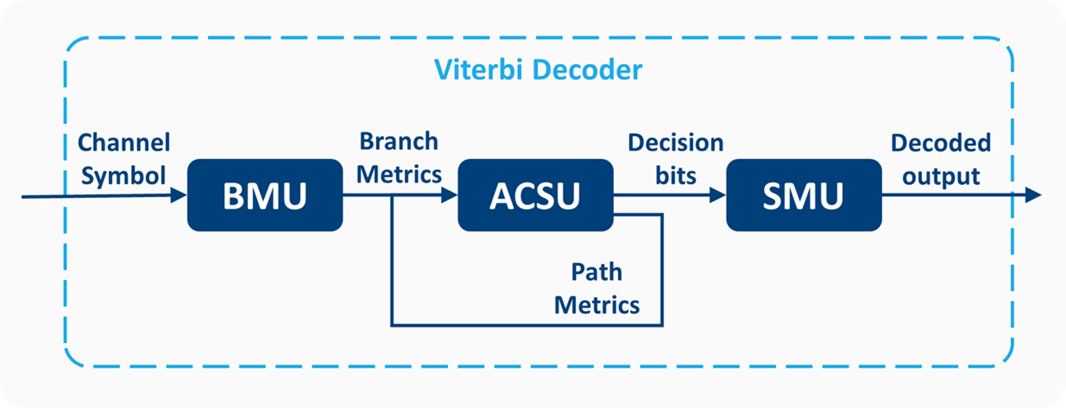
Viterbi Decoder Structure
- BMU
- ACSU
- SMU
Calculate BMs
Add to PMs + Update survivor paths
Select the final survivor path

Slide 61
Literature review
Background
Convolutional encoder
Viterbi Algorithm
Viterbi decoder structure
Different theories
Branch Metric Unit: Hamming, Euclidean & Linear distance
Add-Compare-Select Unit
Survivor Management Unit: Register Exchange & Traceback
Open source Searching

Slide 62
BMU (Branch Metric Unit)

Slide 63
BMU (Branch Metric Unit)
Convolutional encoder
BM: difference

Slide 64
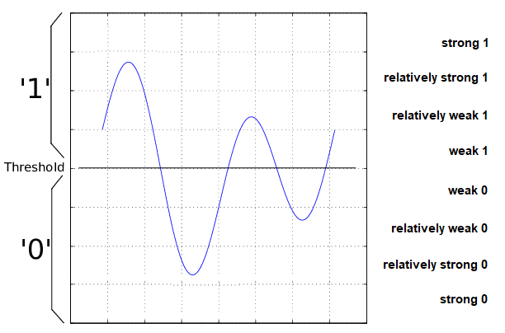
Different quantization
Hard decision
Soft decision
Notes:
Q&A

Slide 65
Requirements
Requirements |  | Requirements
Settings | Settings | (2,1,7) decoder with polynomials [171 133]
Function |  | Soft decision
 |  | De-puncturing
Performance | Processing Delay | ≤10𝜇𝑠
 | Throughput | ≥72.2Mbps
 | Power | Have comparable performance with the Xilinx one
 | Area | The area spanned by the decoder circuit
 | Noise Resilience | Error correction capability

Slide 66
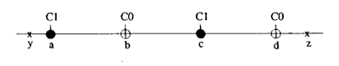

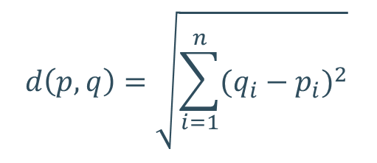
BMU distance - soft decision
Euclidean distance
Decimal results
Linear distance
Integer results
$$d\left(p,q\right)=\sqrt{\sum_{i=1}^{n}{{(q_{i}−p_{i})}^{2}}}$$
Less computational complexity
Notes:
Q&A

Slide 67
Literature review
Background
Convolutional encoder
Viterbi Algorithm
Viterbi decoder structure
Different theories
Branch Metric Unit: Hamming, Euclidean & Linear distance
Add-Compare-Select Unit
Survivor Management Unit: Register Exchange & Traceback
Open source Searching

Slide 68
ACSU (Add-Compare-Select Unit)

Slide 69
ACSU
Repeatedly add, compare and select
Parallel structure to reduce the delay

Slide 70
Literature review
Background
Convolutional encoder
Viterbi Algorithm
Viterbi decoder structure
Different theories
Branch Metric Unit: Hamming, Euclidean & Linear distance
Add-Compare-Select Unit
Survivor Management Unit: Register Exchange & Traceback
Open source Searching

Slide 71
SMU (Survivor Management Unit)

Slide 72
SMU structure
Register Exchange (RE)
Traceback (TB)
Write/Read the correct paths
Reflash all the registers when new input comes
Immediate output after receiving the last input
Write/Read the previous most/least significant bits
Only Update the latest register bits
Need time to trace the sequence

Slide 73
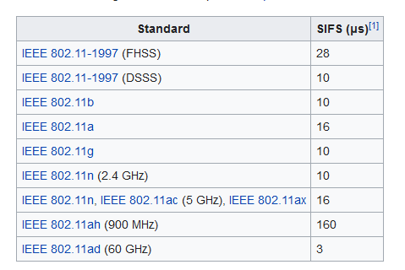
RE v.s. TB
Register Exchange (RE)
Traceback (TB)
Low delay
Large power consumption and large slice area
Low power consumption
Relatively big delay
100MHz clock
Max delay: 1000 clock cycles
Normal parallel TB: around 200 clock cycles delay
Notes:
Q&A

Slide 74
Traceback (TB)
Register Exchange (RE)
Traceback (TB)
Write/Read the correct paths
Reflash all the registers when new input comes
Immediate output after receiving the last input
Write/Read the previous most/least significant bits
Only Update the latest register bits
Need time to trace the sequence

Slide 75
TB - writing
[]: RAMs (FILO)
00
[
]
[
01
]
[
10
]
[
11
]
t = 1
t = 2

Slide 76
TB - writing
[]: RAMs (FILO)
00
[
0
]
[
0
01
]
[
0
10
]
[
0
11
]
t = 1
t = 2

Slide 77
TB - writing
[]: RAMs (FILO)
00
[
0
]
[
0
01
]
[
0
10
]
[
0
11
]
t = 1
t = 2
t = 3

Slide 78
TB - writing
[]: RAMs (FILO)
00
[
0
0
]
[
0
0
01
]
[
0
0
10
]
[
0
0
11
]
t = 1
t = 2
t = 3

Slide 79
TB - writing
[]: RAMs (FILO)
00
[
0
0
]
[
0
0
01
]
[
0
0
10
]
[
0
0
11
]
t = 1
t = 2
t = 3
t = 4

Slide 80
TB - writing
[]: RAMs (FILO)
00
[
0
0
1
]
[
0
0
1
01
]
[
0
0
1
10
]
[
0
0
1
11
]
t = 1
t = 2
t = 3
t = 4

Slide 81
TB - writing
[]: RAMs (FILO)
00
[
0
0
1
]
[
0
0
1
01
]
[
0
0
1
10
]
[
0
0
1
11
]
t = 1
t = 2
t = 3
t = 4
t = 5

Slide 82
TB - writing
[]: RAMs (FILO)
00
[
0
0
1
1
]
[
0
0
1
1
01
]
[
0
0
1
0
10
]
[
0
0
1
1
11
]
t = 1
t = 2
t = 3
t = 4
t = 5

Slide 83
TB - writing
[]: RAMs (FILO)
00
[
0
0
1
1
]
[
0
0
1
1
01
]
[
0
0
1
0
10
]
[
0
0
1
1
11
]
t = 1
t = 2
t = 3
t = 4
t = 5
t = 6

Slide 84
TB - writing
[]: RAMs (FILO)
00
[
0
0
1
1
0
]
[
0
0
1
1
0
01
]
[
0
0
1
0
1
10
]
[
0
0
1
1
0
11
]
t = 1
t = 2
t = 3
t = 4
t = 5
t = 6

Slide 85


TB - reading principle
output
RAM
$S_{1}$
$S_{0}$
Current state
Previous state

Slide 86
Select final survivor path
BM
1
00
=
PM1
2
1
0
1
01
=
PM2
2
1
=
10
0
PM3
2
0
0
0
=
11
PM4
1
2
0
t = 1
t = 2
t = 3
t = 4
t = 5
t = 6

Slide 87
TB - reading
00
[
0
0
1
1
0
]
[
0
0
1
1
0
01
]
[
0
0
1
0
1
10
]
[
0
0
1
1
0
1
]
1
11
12
t = 1
t = 2
t = 3
t = 4
t = 5
t = 6

Slide 88
TB - reading
11
12
00
[
0
0
1
1
0
]
[
0
0
1
1
0
01
]
[
0
0
1
0
1
10
]
[
0
0
1
1
05
1
]
1
t = 1
t = 2
t = 3
t = 4
t = 5
t = 6

Slide 89
TB - reading
11
05
12
00
[
0
0
1
1
0
]
[
0
0
1
1
0
01
]
[
0
0
1
0
1
10
]
[
0
0
1
1
1
]
1
t = 1
t = 2
t = 3
t = 4
t = 5
t = 6

Slide 90
TB - reading
12
11
05
00
[
0
0
1
1
]
[
0
0
1
1
01
]
[
0
0
1
0
10
]
[
0
0
1
1
1
]
1
t = 1
t = 2
t = 3
t = 4
t = 5

Slide 91
TB - reading
12
11
05
00
[
0
0
1
1
]
[
0
0
1
13
01
]
[
0
0
1
0
10
]
[
0
0
1
1
1
]
1
t = 1
t = 2
t = 3
t = 4
t = 5

Slide 92
TB - reading
12
13
11
05
00
[
0
0
1
1
]
[
0
0
1
01
]
[
0
0
1
0
10
]
[
0
0
1
1
1
]
1
t = 1
t = 2
t = 3
t = 4
t = 5

Slide 93
TB - reading
11
12
13
05
00
[
0
0
1
]
[
0
0
1
01
]
[
0
0
1
10
]
[
0
0
1
1
]
1
t = 1
t = 2
t = 3
t = 4

Slide 94
TB - reading
11
12
13
05
00
[
0
0
1
]
[
0
0
1
01
]
[
0
0
14
10
]
[
0
0
1
1
]
1
t = 1
t = 2
t = 3
t = 4

Slide 95
TB - reading
11
12
14
13
05
00
[
0
0
1
]
[
0
0
1
01
]
[
0
0
10
]
[
0
0
1
1
]
1
t = 1
t = 2
t = 3
t = 4

Slide 96
TB - reading
05
11
12
14
13
00
[
0
0
]
[
0
0
01
]
[
0
0
10
]
[
0
0
1
]
1
t = 1
t = 2
t = 3

Slide 97
TB - reading
05
11
12
14
13
00
[
0
0
]
[
0
0
01
]
[
0
0
10
]
[
0
02
1
]
1
t = 1
t = 2
t = 3

Slide 98
TB - reading
05
11
12
02
14
13
00
[
0
0
]
[
0
0
01
]
[
0
0
10
]
[
0
1
]
1
t = 1
t = 2
t = 3

Slide 99
TB - reading
13
05
11
12
02
14
00
[
0
]
[
0
01
]
[
0
10
]
[
0
1
]
1
t = 1
t = 2

Slide 100
TB - reading
13
05
11
12
02
14
00
[
0
]
[
03
01
]
[
0
10
]
[
0
1
]
1
t = 1
t = 2

Slide 101
TB - reading
13
05
11
12
03
02
14
00
[
0
]
[
01
]
[
0
10
]
[
0
1
]
1
t = 1
t = 2

Slide 102
TB - reading
14
13
05
11
12
03
02
00
[
]
[
01
]
[
10
]
[
1
]
1
t = 1

Slide 103
TB - reading
Decoded
12
11
05
13
14
Last
First

Slide 104
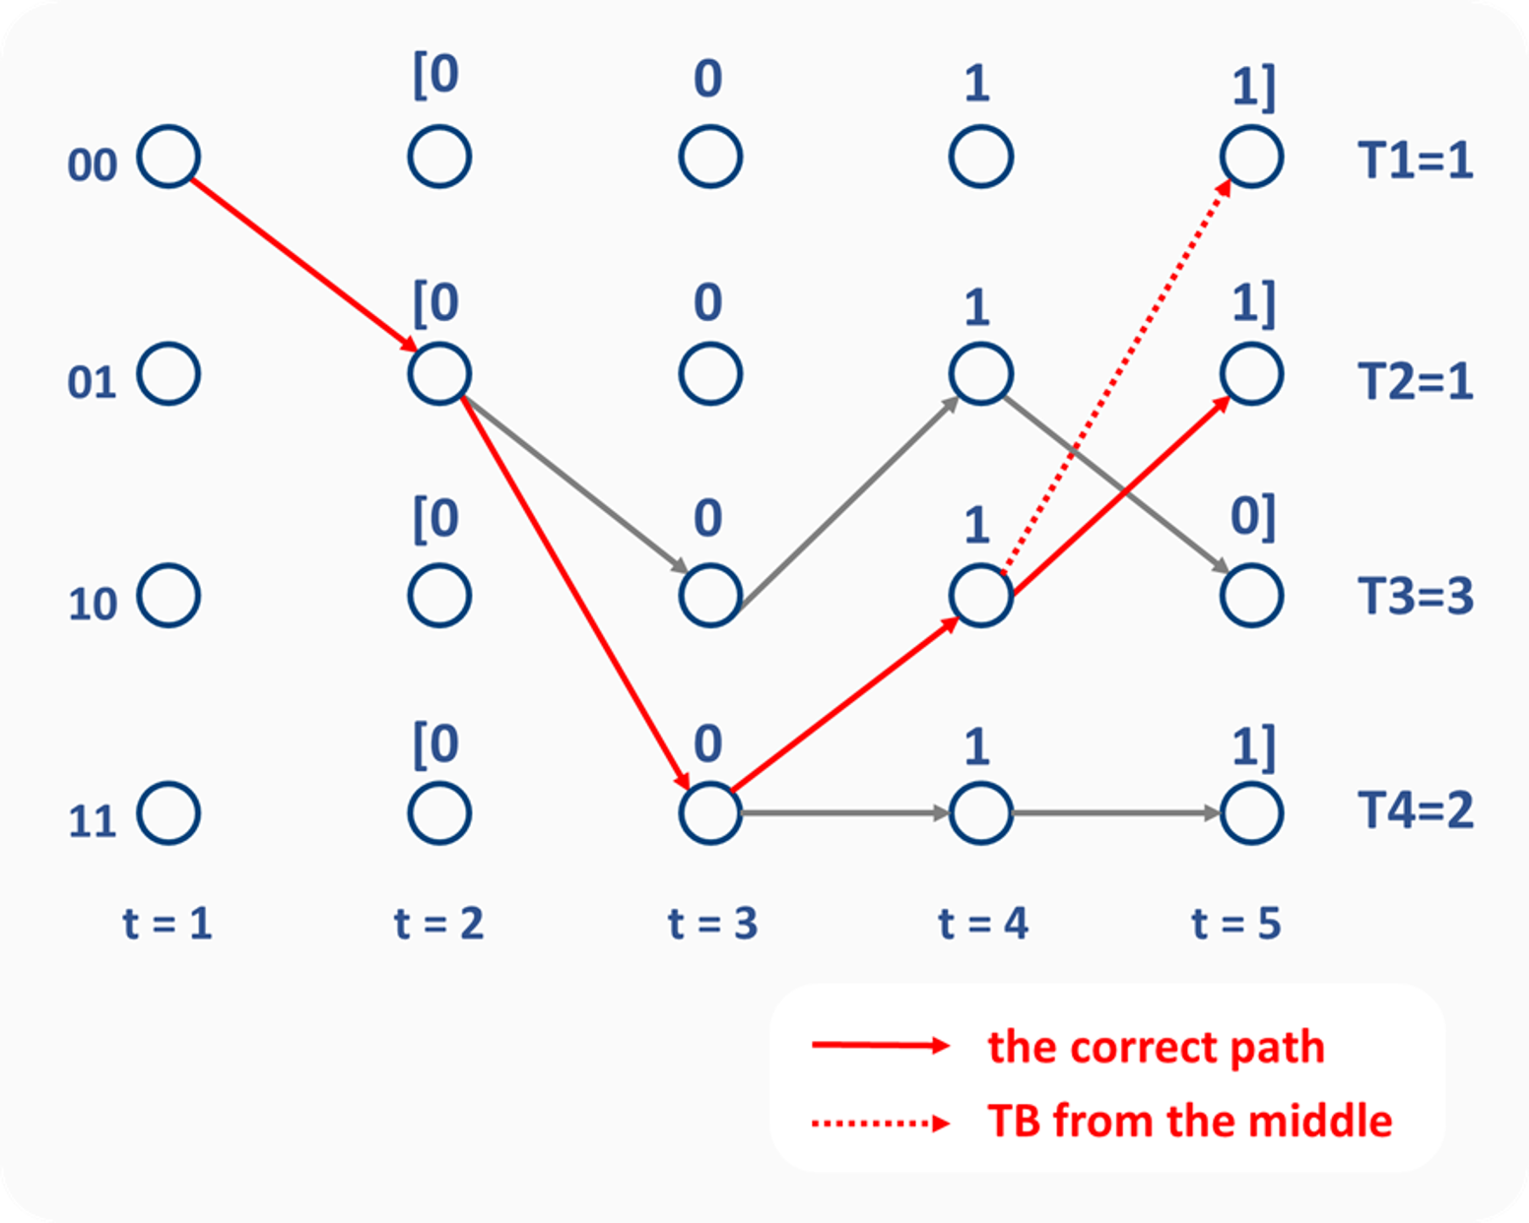
TB Problem
Only give output after receiving the full sequence
Trace back from middle will cause problems

Slide 105
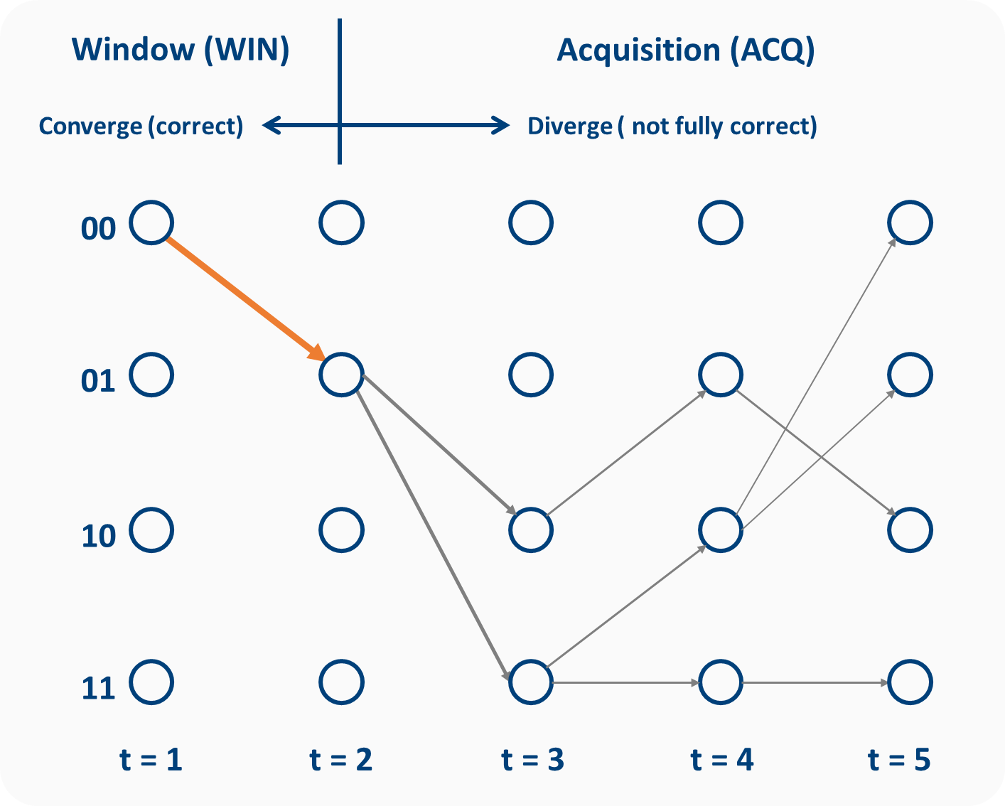
Unification property
The TB can converge to the correct path after some samples
Cypher and Shung (2002)

Slide 106
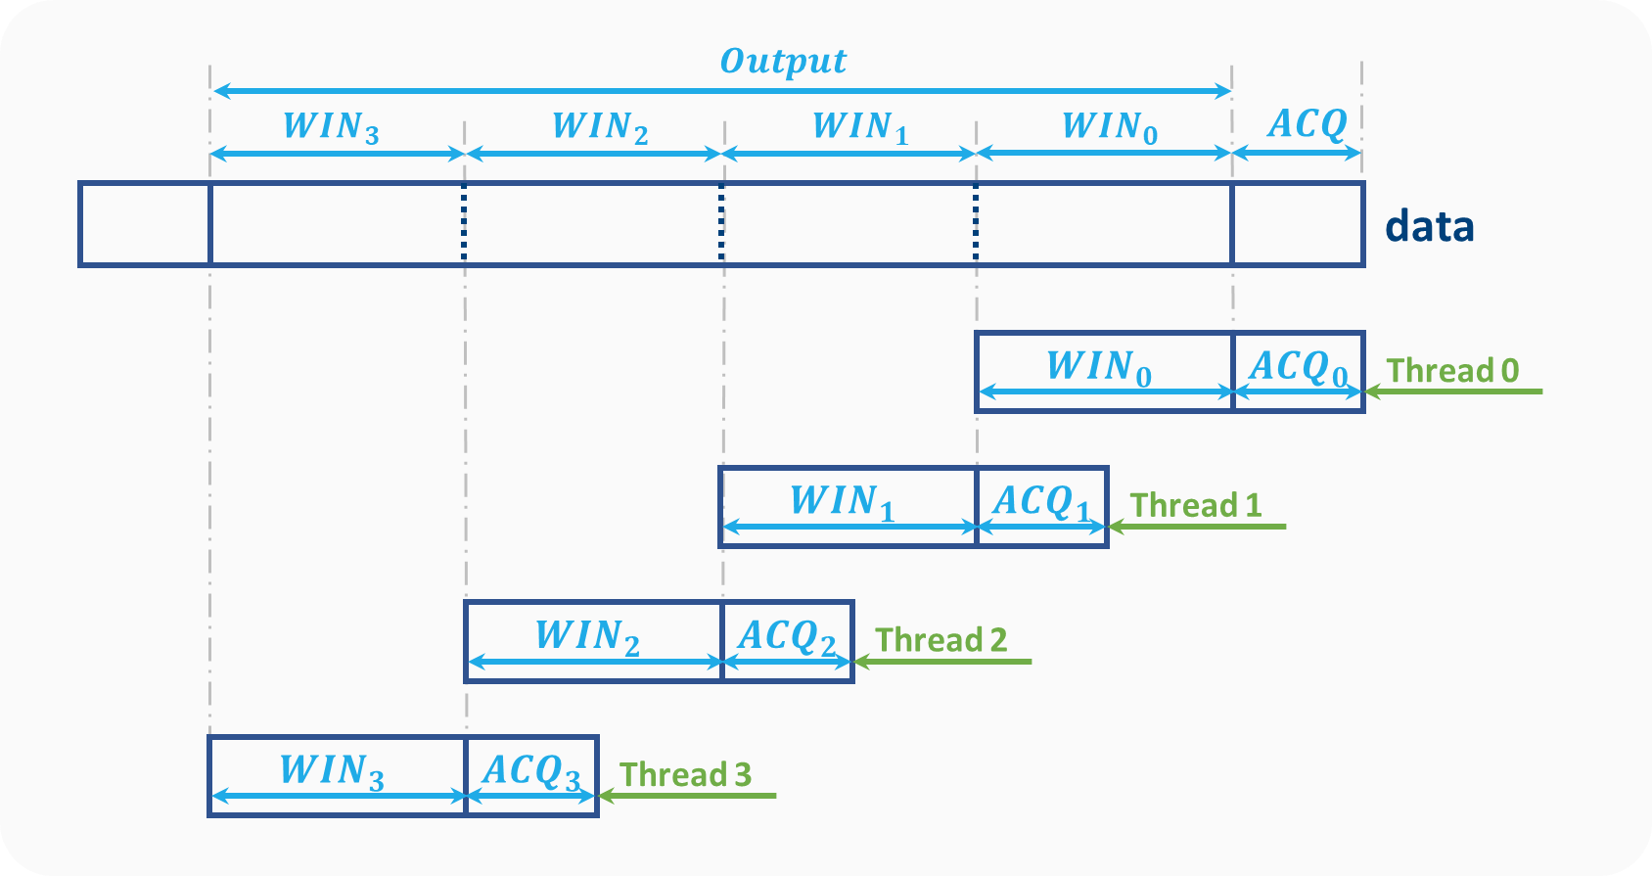
Parallel traceback algorithm
Mohammadidoost and Hashemi (2020)

Slide 107
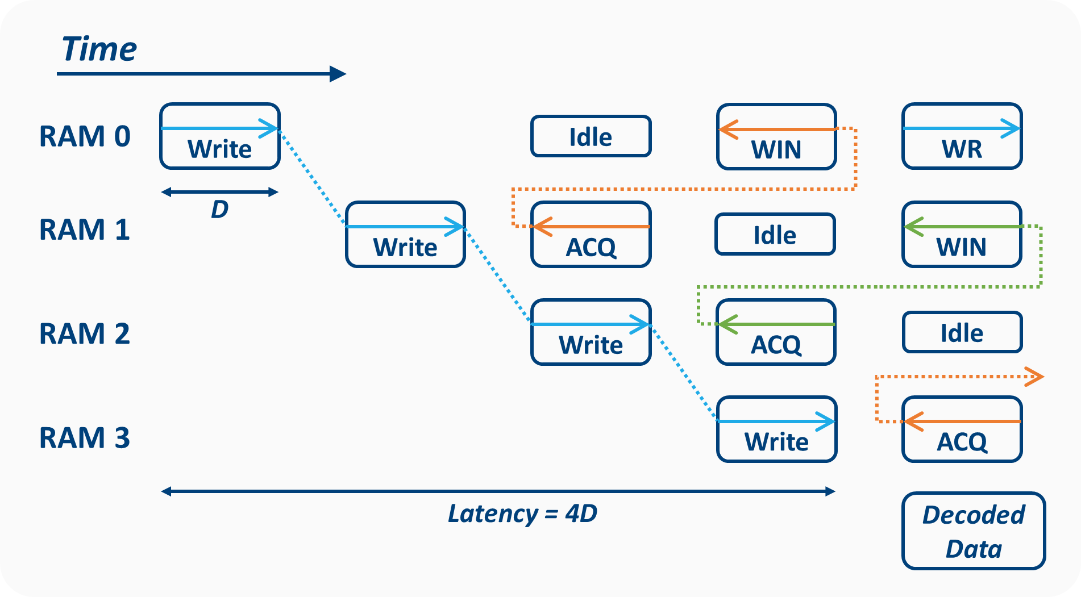
Parallel traceback structure
Angarita et al. (2008)

Slide 108
Literature review
Background
Convolutional encoder
Viterbi Algorithm
Viterbi decoder architecture & flow chart
Different theories
Branch Metric Unit: Hamming, Euclidean & Linear distance
Add-Compare-Select Unit
Survivor Management Unit: Register Exchange & Traceback
Open source Searching

Slide 109


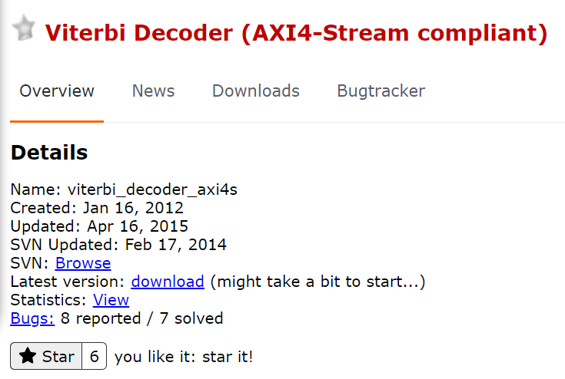



Open source Searching
Requirements | Requirements | Open Source
Settings | (2,1,7) decoder with polynomials [171 133]
Function | Soft decision
 | De-puncturing
Notes:
Linear
Parallel ACSU
Parallel TB

Slide 110
Implementation
Open source Viterbi decoder
Branch Metric Unit
Add–Compare–Select Unit
Survivor Management Unit
Reorder Unit
Ported process
Add the de-puncturing function
Adjust the ports
Other Considerations

Slide 111
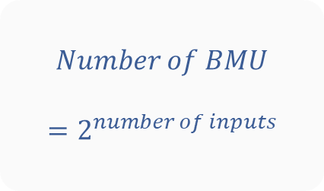
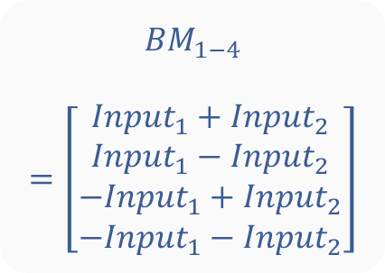
Implementation BMU
adder
BM1
$$Number of BMU$$
$$=2^{number of inputs}$$
Input 1
adder
BM2
adder
$${BM}_{1−4}$$
$$=\left[\begin{aligned}{Input}_{1}+{Input}_{2} \\ {Input}_{1}−{Input}_{2} \\ −{Input}_{1}+{Input}_{2} \\ −{Input}_{1}−{Input}_{2}\end{aligned}\right]$$
BM3
Input 2
adder
BM4

Slide 112
Implementation
Open source Viterbi decoder
Branch Metric Unit
Add–Compare–Select Unit
Survivor Management Unit
Reorder Unit
Ported process (Our contribution)
Add the de-puncturing function
Adjust the ports
Other Considerations

Slide 113
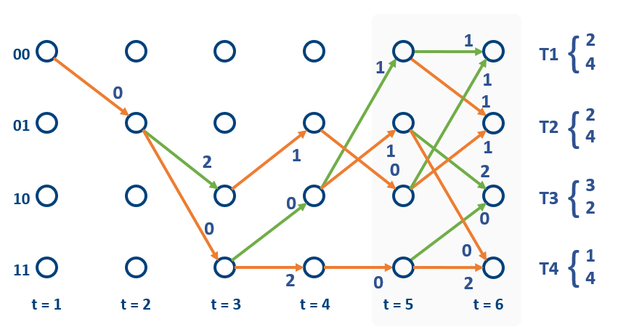
Implementation ACSU
Previous Example:
$Number of ACSU=Number of states=2^{K−1}$ K: constraint length

Slide 114
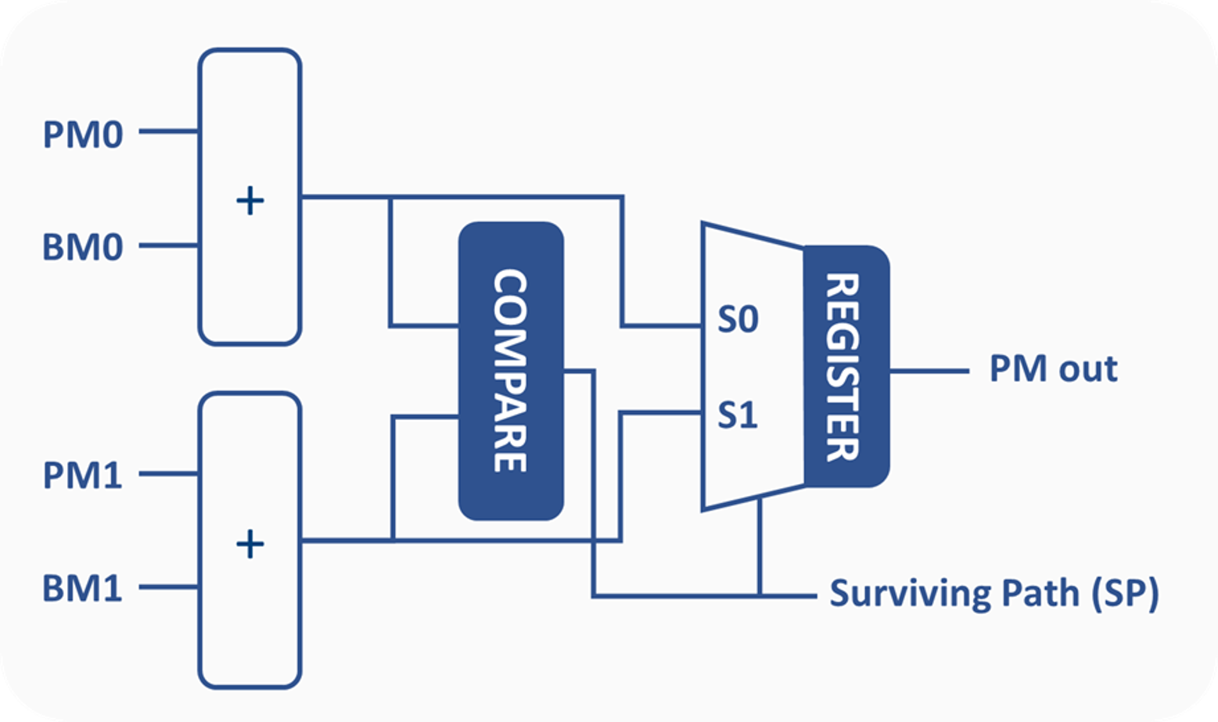

Implementation ACSU
+
+
$$×64$$
+
+
+
+
+
+

Slide 115
Implementation
Open source Viterbi decoder
Branch Metric Unit
Add–Compare–Select Unit
Survivor Management Unit
Reorder Unit
Ported process (Our contribution)
Add the de-puncturing function
Adjust the ports
Other Considerations

Slide 116
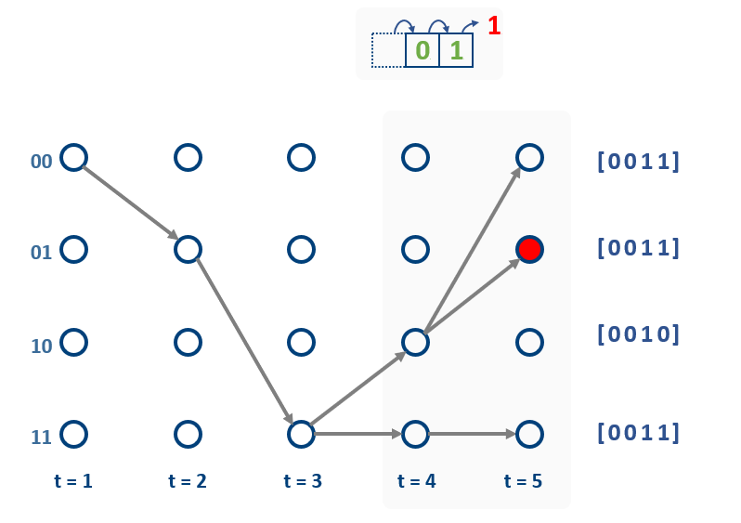
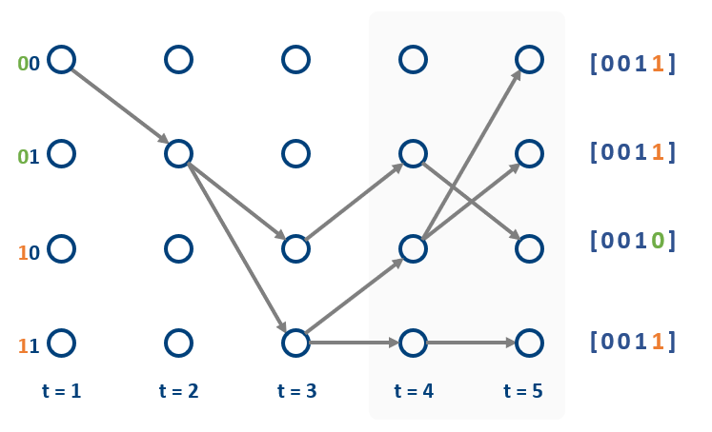
Implementation SMU
Previous Example (TB):
Writing
Reading
SMU: 4 RAM + 2 Traceback

Slide 117
Parallel traceback structure
Angarita et al. (2008)

Slide 118
Implementation SMU
ACQ
WIN
T =
0
01
+
2
01
01
01
3
01
XX
+
Write to RAM
01
01
01
01
01
Traceback module 1
+
Traceback module 2
+
12
03
06
09
+
01
04
07
+
10
02
05
08
11
+
RAM 1
RAM 2
RAM 3
RAM 4
+

Slide 119
Parallel traceback structure
Angarita et al. (2008)

Slide 120
Implementation SMU
ACQ
WIN
T =
0
01
01
01
01
01
+
XX
+
Write to RAM
01
01
01
01
01
Traceback module 1
+
Traceback module 2
+
12
03
06
09
+
01
04
07
+
10
02
05
08
11
+
RAM 1
RAM 2
RAM 3
RAM 4
+

Slide 121
Implementation SMU
ACQ
WIN
T =
1
01
01
01
01
01
+
XX
+
Write to RAM
01
01
01
01
01
Traceback module 1
+
Traceback module 2
+
12
03
06
09
+
01
04
07
+
10
02
05
08
11
+
RAM 1
RAM 2
RAM 3
RAM 4
+

Slide 122
Implementation SMU
ACQ
WIN
T =
2
01
01
01
01
01
+
XX
+
Write to RAM
01
01
01
01
01
Traceback module 1
+
Traceback module 2
+
12
03
06
09
+
01
04
07
+
10
02
05
08
11
+
RAM 1
RAM 2
RAM 3
RAM 4
+

Slide 123
Implementation SMU
ACQ
WIN
T =
3
01
01
01
01
01
+
XX
+
Write to RAM
01
01
01
01
01
Traceback module 1
+
Traceback module 2
+
12
03
06
09
+
01
04
07
+
10
02
05
08
11
+
RAM 1
RAM 2
RAM 3
RAM 4
+

Slide 124
Implementation SMU
ACQ
WIN
T =
4
01
01
01
01
01
+
XX
+
Write to RAM
01
01
01
01
01
Traceback module 1
+
Traceback module 2
+
12
03
06
09
+
01
04
07
+
10
02
05
08
11
+
RAM 1
RAM 2
RAM 3
RAM 4
+

Slide 125
Implementation SMU
ACQ
WIN
T =
5
01
01
01
01
01
+
XX
+
Write to RAM
01
01
01
01
01
Traceback module 1
+
Traceback module 2
+
12
03
06
09
+
01
04
07
+
10
02
05
08
11
+
RAM 1
RAM 2
RAM 3
RAM 4
+

Slide 126
Implementation SMU
ACQ
WIN
T =
6
01
01
01
01
01
+
XX
+
Write to RAM
01
01
01
01
01
Traceback module 1
+
Traceback module 2
+
12
03
06
09
+
01
04
07
+
10
02
05
08
11
+
RAM 1
RAM 2
RAM 3
RAM 4
+

Slide 127
Implementation SMU
ACQ
WIN
T =
7
05
01
01
01
01
+
XX
+
Write to RAM
01
01
01
01
01
Traceback module 1
+
Traceback module 2
+
12
03
06
09
+
01
04
07
+
10
02
05
08
11
+
RAM 1
RAM 2
RAM 3
RAM 4
+

Slide 128
Implementation SMU
ACQ
WIN
T =
8
05
04
01
01
01
+
XX
+
Write to RAM
01
01
01
01
01
Traceback module 1
+
Traceback module 2
+
12
03
06
09
+
01
04
07
+
10
02
05
08
11
+
RAM 1
RAM 2
RAM 3
RAM 4
+

Slide 129
Implementation SMU
ACQ
WIN
T =
9
05
04
03
01
01
+
XX
+
Write to RAM
01
01
01
01
01
Traceback module 1
+
Traceback module 2
+
12
03
06
09
+
01
04
07
+
10
02
05
08
11
+
RAM 1
RAM 2
RAM 3
RAM 4
+

Slide 130
Implementation SMU
ACQ
WIN
T =
10
05
04
03
02
01
+
XX
+
Write to RAM
08
01
01
01
01
Traceback module 1
+
Traceback module 2
+
12
03
06
09
+
01
04
07
+
10
02
05
08
11
+
RAM 1
RAM 2
RAM 3
RAM 4
+

Slide 131
Implementation SMU
ACQ
WIN
T =
11
05
04
03
02
01
+
XX
+
Write to RAM
08
07
01
01
01
Traceback module 1
+
Traceback module 2
+
12
03
06
09
+
01
04
07
+
10
02
05
08
11
+
RAM 1
RAM 2
RAM 3
RAM 4
+
$$Delay≈(WIN+ACQ)×2$$

Slide 132
Implementation SMU
ACQ
WIN
T =
12
05
04
03
02
01
+
XX
+
Write to RAM
08
07
06
01
01
Traceback module 1
+
Traceback module 2
+
12
03
06
09
+
01
04
07
+
10
02
05
08
11
+
RAM 1
RAM 2
RAM 3
RAM 4
+

Slide 133
Implementation SMU
ACQ
WIN
T =
13
11
04
03
02
01
+
XX
+
Write to RAM
08
07
06
05
01
Traceback module 1
+
Traceback module 2
+
12
03
06
09
+
13
04
07
+
10
02
05
08
11
+
RAM 1
RAM 2
RAM 3
RAM 4
+

Slide 134
Implementation SMU
ACQ
WIN
T =
14
11
10
03
02
01
+
XX
+
Write to RAM
08
07
06
05
04
Traceback module 1
+
Traceback module 2
+
12
03
06
09
+
13
04
07
+
10
14
05
08
11
+
RAM 1
RAM 2
RAM 3
RAM 4
+

Slide 135
Implementation SMU
ACQ
WIN
T =
15
11
10
09
02
01
+
XX
+
Write to RAM
08
07
06
05
04
Traceback module 1
+
Traceback module 2
+
12
15
06
09
+
13
04
07
+
10
14
05
08
11
+
RAM 1
RAM 2
RAM 3
RAM 4
+

Slide 136
Implementation SMU
ACQ
WIN
T =
16
11
10
09
08
01
+
XX
+
Write to RAM
14
07
06
05
04
Traceback module 1
+
Traceback module 2
+
12
15
06
09
+
13
16
07
+
10
14
05
08
11
+
RAM 1
RAM 2
RAM 3
RAM 4
+

Slide 137
Implementation SMU
ACQ
WIN
T =
17
11
10
09
08
07
+
XX
+
Write to RAM
14
13
06
05
04
Traceback module 1
+
Traceback module 2
+
12
15
06
09
+
13
16
07
+
10
14
17
08
11
+
RAM 1
RAM 2
RAM 3
RAM 4
+

Slide 138
Implementation SMU
ACQ
WIN
T =
18
11
10
09
08
07
+
XX
+
Write to RAM
14
13
12
05
04
Traceback module 1
+
Traceback module 2
+
12
15
18
09
+
13
16
07
+
10
14
17
08
11
+
RAM 1
RAM 2
RAM 3
RAM 4
+

Slide 139
Implementation SMU
ACQ
WIN
T =
19
17
10
09
08
07
+
XX
+
Write to RAM
14
13
12
11
04
Traceback module 1
+
Traceback module 2
+
12
15
18
09
+
13
16
19
+
10
14
17
08
11
+
RAM 1
RAM 2
RAM 3
RAM 4
+

Slide 140
Implementation SMU
ACQ
WIN
T =
20
17
16
09
08
07
+
XX
+
Write to RAM
14
13
12
11
10
Traceback module 1
+
Traceback module 2
+
12
15
18
09
+
13
16
19
+
10
14
17
20
11
+
RAM 1
RAM 2
RAM 3
RAM 4
+

Slide 141
Implementation
Open source Viterbi decoder
Branch Metric Unit
Add–Compare–Select Unit
Survivor Management Unit
Reorder Unit
Ported process (Our contribution)
Add the de-puncturing function
Adjust the ports
Other Considerations

Slide 142
Implementation Reorder
T =
05
04
05
04
05
04
05
04
ACQ
+
+
WIN
03
02
01
06
05
04
09
08
07
12
11
10
…
+
+
…
03
…
03
02
02
01
01
09
09
08
08
07
06
07
06
05
05
04
04
12
12
11
11
10
Output from ACSU
10
+
+
+
+

Slide 143
Implementation Reorder
T =
+
+
WIN
03
02
01
06
05
04
09
08
07
12
11
10
…
+
03
02
01
09
+
…
Output from ACSU
06
05
04
08
07
12
11
10
+
01
02
03
04
05
06
07
08
09
10
11
12
…
Reorder
+
+
Two series of shift Registers
+

Slide 144
Implementation
Open source Viterbi decoder
Branch Metric Unit
Add–Compare–Select Unit
Survivor Management Unit
Reorder Unit
Ported process
Add the de-puncturing function
Adjust the ports
Other Considerations

Slide 145
Open source Searching
Requirements | Requirements | Open Source
Settings | (2,1,7) decoder with polynomials [171 133]
Function | Soft decision
 | De-puncturing
Notes:
Linear
TB

Slide 146
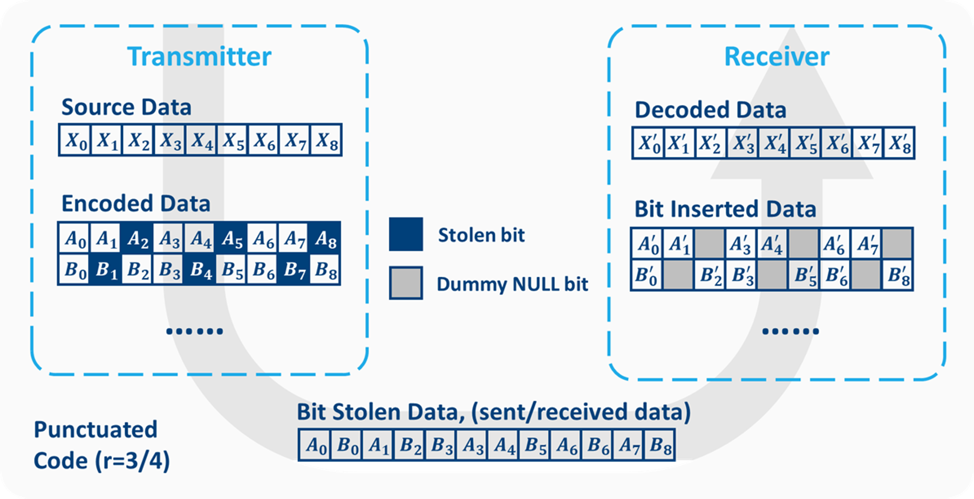
De-puncturing
Notes:
Convolutional code: self correction property
De-puncturing: adjust coding rate
Not supported by the open source

Slide 147
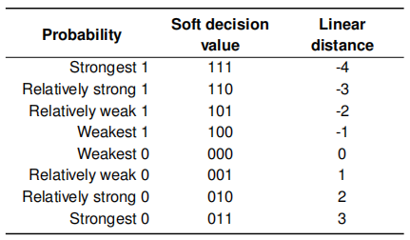
Dummy NULL bits problem
Before
number axis
-7
-5
-3
-1
0
1
3
5
7
Notes:
Lies exactly nutually

Slide 148
Dummy NULL bits problem
Before
number axis
-7
-5
-3
-1
0
1
3
5
7

Slide 149
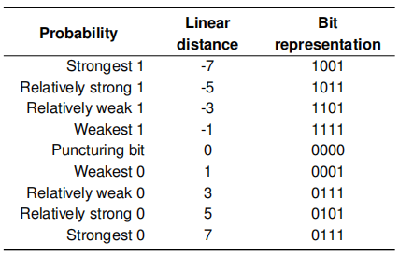
Dummy NULL bits problem
Before
number axis
-7
-5
-3
-1
0
1
3
5
7
After
Dummy NULL bit

Slide 150
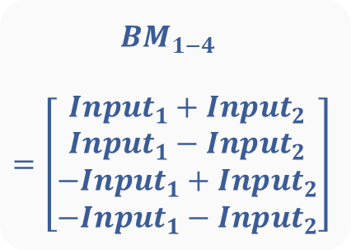
BMU - Original
adder
BM1
Input 1
adder
BM2
$${BM}_{1−4}$$
$$=\left[\begin{aligned}{Input}_{1}+{Input}_{2} \\ {Input}_{1}−{Input}_{2} \\ −{Input}_{1}+{Input}_{2} \\ −{Input}_{1}−{Input}_{2}\end{aligned}\right]$$
adder
BM3
Input 2
adder
BM4

Slide 151
BMU - Ported
adder
BM1
De-puncturing
Input 1
adder
BM2
adder
De-puncturing
BM3
Input 2
adder
BM4

Slide 152
Implementation
Open source Viterbi decoder
Branch Metric Unit
Add–Compare–Select Unit
Survivor Management Unit
Reorder Unit
Ported process (Our contribution)
Add the de-puncturing function
Adjust the ports
Other Considerations

Slide 153
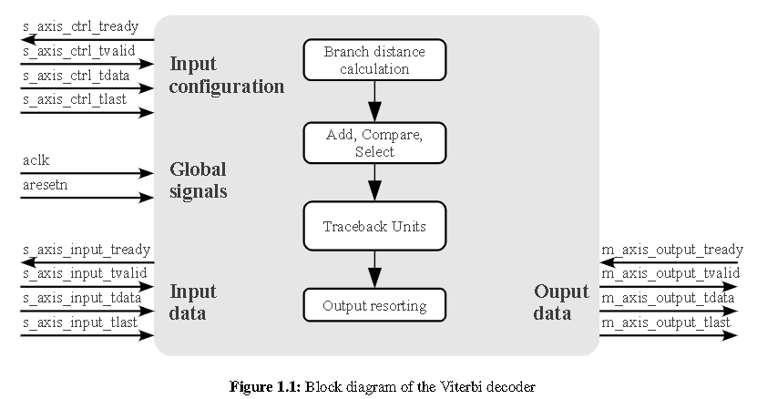
Adjust the ports

Slide 154
Adjust the ports
Fixed traceback depth

Slide 155
Adjust the ports
Data flow
Decoder input and output is always ready

Slide 156
Adjust the ports
External reset
External control and reset from upper module

Slide 157
Adjust the ports
De-puncturing signal
s_axis_input_tuser
De-puncturing function

Slide 158
Implementation
Open source Viterbi decoder
Branch Metric Unit
Add–Compare–Select Unit
Survivor Management Unit
Reorder Unit
Ported process (Our contribution)
Add the de-puncturing function
Adjust the ports
Other Considerations

Slide 159
Other Considerations
ACSU
9-bit PMs for normalization to prevent overflow
SMU
two threads traceback
ACQ = 50 & WIN = 55
Notes:
Q&A

Slide 160
Results
Environment
Performance
Processing delay
Throughput
Noise resilience
Energy and Area consumption
Validation on the board

Slide 161
Environment
Design
Simulation
Synthesis
Xilinx Vivado 2018.3
Add white Gaussian noise
Plot BER
MATLAB R2022a

Slide 162
Results
Environment
Performance
Processing delay
Throughput
Noise resilience
Energy and Area consumption
Validation on the board

Slide 163
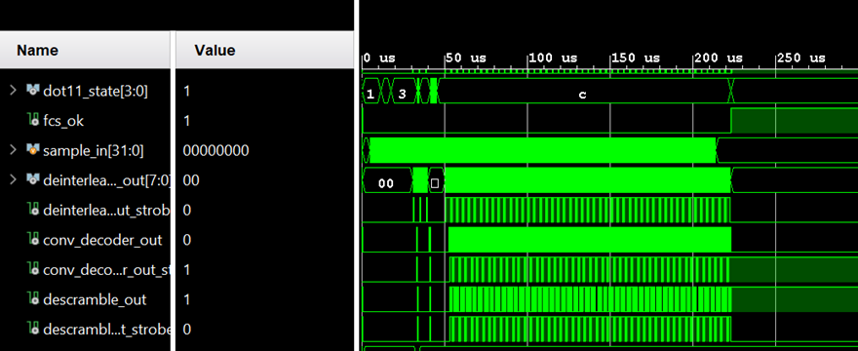
dot11_state
Receiver module FSM
Range: 0-c (hex)
0: initial
c: data decoding

Slide 164
fcs_ok
CRC flag after decoding
1: correct
0: fault

Slide 165
sample_in
Samples from I/Q files

Slide 166
deinterleave_out
Output from
De-interleave module

Slide 167
conv_out
Output from
decoder module

Slide 168
descramble_out
Output from
De-scrambler module

Slide 169
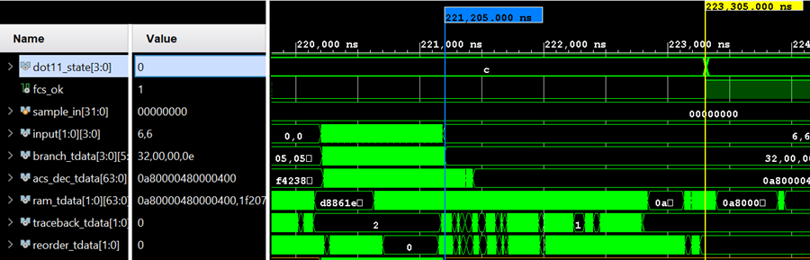
Performance: Processing delay
Last bit enter
Last bit output

Slide 170
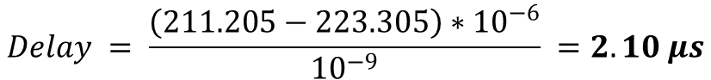
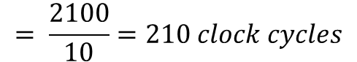
Performance: Processing delay
Last bit enter
Last bit output
$$Delay = \frac{\left(211.205−223.305\right)∗{10}^{−6}}{{10}^{−9}} =2.10 μs$$
$$= \frac{2100}{10}=210 clock cycles$$
Clock: 100 MHz (10ns)
$$Theriotical Delay≈(WIN+ACQ)×2 ≈210$$

Slide 171
Performance: Throughput
How
Pipeline outputs one bit per clock cycle
Theoretical Throughput
= Clock Frequency
Throughput
Why
What
Result

Slide 172
Performance: Throughput
Why
Evaluate by synthesize with different clock constraints to find the maximum operational clock frequency
Throughput
Result
How
What

Slide 173
Performance: Throughput
Result
The physical limitation is driven by the critical paths in the processing pipeline.
Throughput
What
Why
How

Slide 174
Performance: Throughput
What
Throughput
Maximum frequency was limited to
204MHz
How
Result
Why

Slide 175




Performance: Noise resilience
I/Q files
Add Gaussian White noise
Simulate in the receiving module
Fetch the output after decoder
Calculate BERs and plot the graph

Slide 176
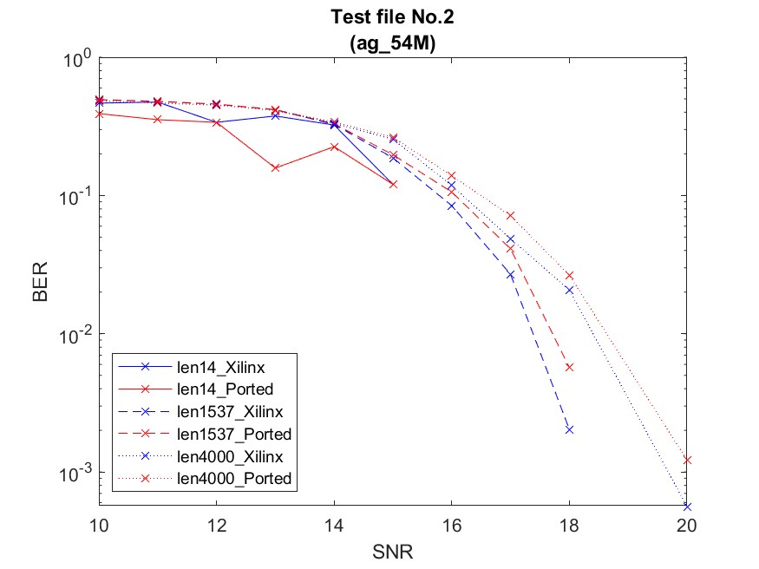
Performance: BER plots
Protocol - 802.11a/g
Bit rate - 54Mbps
Modulation - 64 QAM
<1dB

Slide 177
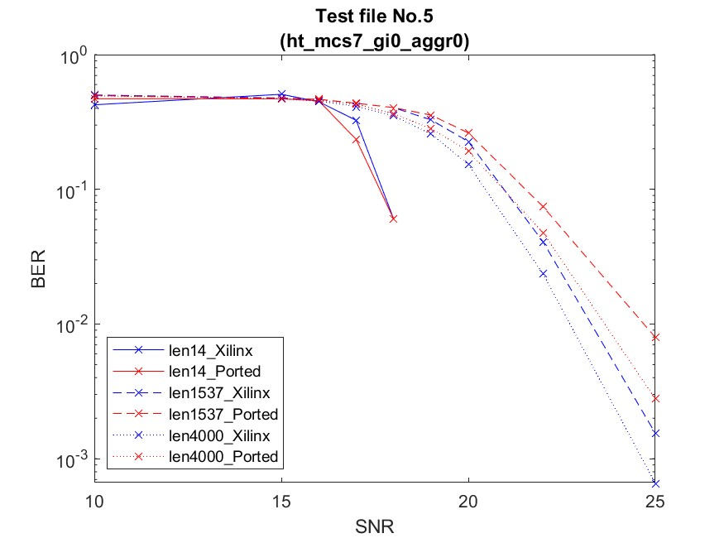
Performance: BER plots
Protocol - 802.11n
Bit rate - 65Mbps
Modulation - 64 QAM
<1dB

Slide 178
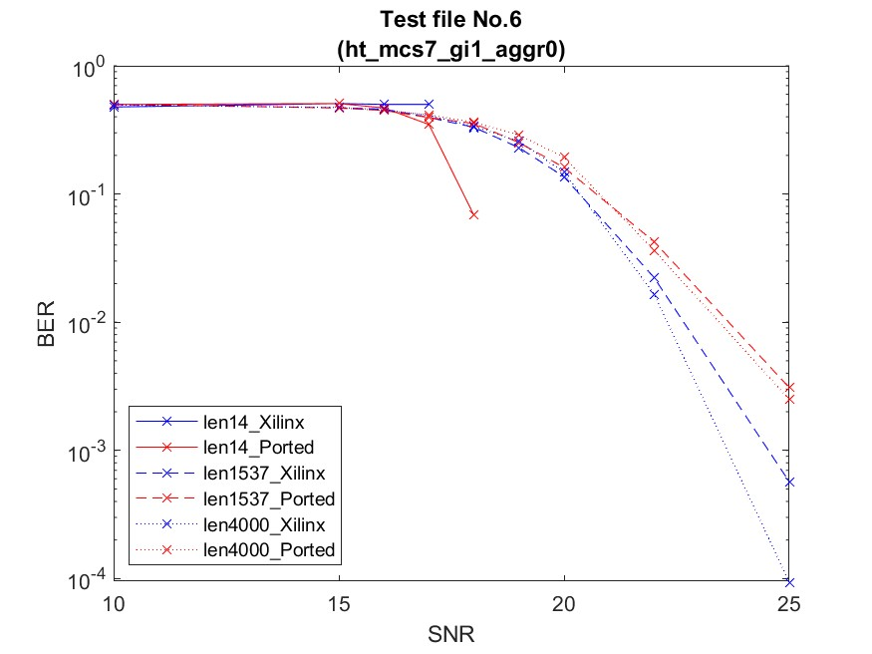
Performance: BER plots
Protocol - 802.11n
Bit rate – 72.2Mbps
Modulation - 64 QAM
<1dB

Slide 179
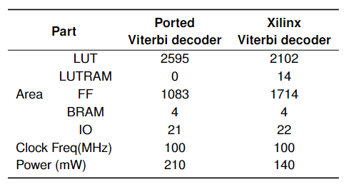
Performance: Energy and Area consumption
Table. Utilization reports in the synthesis
Summary
larger area
higher energy consumption
Still has room for improvement

Slide 180
Results
Environment
Performance
Processing delay
Throughput
Noise resilience
Energy and Area consumption
Validation on the board

Slide 181
Validation on the board
Correct simulation result of the decoder itself
Ported Viterbi decoder OpenWiFi project
Unfunctional in OpenWiFi whole project

Slide 182
Validation on the board
Unfunctional in OpenWiFi whole project
Break the handshakes between the decoder and the rest of the system

Slide 183
Discussion
Performance
Limitations & Future work

Slide 184
Performance
Requirements |  | Requirements | Results
Settings | Settings | (2,1,7) decoder with polynomials [171 133] | √
Function |  | Soft decision | √
 |  | De-puncturing | √
Performance | Processing Delay | ≤10𝜇𝑠 | 2.12𝜇𝑠 √
 | Throughput | ≥72.2Mbps | 204Mbps √
 | Power | Have compatible performance with the Xilinx one | √
 | Area | The area spanned by the decoder circuit
 | Noise Resilience | Error correction capability

Slide 185
Discussion
Performance
Limitations & Future work

Slide 186
Limitations & Future work
Final integration on board was not fully functional
Need more time to debug on simulation
Future improvement in performance
Advanced algorithms
Forward Traceback Method (Zhao et al., 2017)
reduce delay by 25%
T-algorithm (Surya et al., 2021)
reduce area and power consumption by 20%

Slide 187
Conclusions
Basic achievements
Correct decoded simulation results
Promising synthesis result
Performed comparably to the proprietary Xilinx’s Viterbi decoder
Highlight
Open source hardware design

Slide 188
Q & A
Previous Slides
Introduction
Topic, Aims, Importance, Objectives, Requirements
Literature review
Background: Encoder, Algorithm, Architecture
Theores: BMU (distances), ACSU, SMU (RE, TB)
Decoder: Xilinx, Open source
Implementation
open source: BMU, ACSU, SMU, Reorder
Ported: De-puncturing, Adjust the ports, Others
Results
Environment
Performance: Delay, Throughput, BER, Conssumption
Validation on the board
Discussion: Performance, Future work
Conclusions
Appendix
BMU
Distance calculation
ACSU
Nomarlization for overflow
SMU
RE algorithm
Multiple threads TB
ACQ &WIN selection
Results
Full enviroment
BER test files
Max clock frequency - 204MHz
Validation on board
Discussion
Advanced algorithms
Xilinx

Slide 189
Thanks for your attention

Slide 190
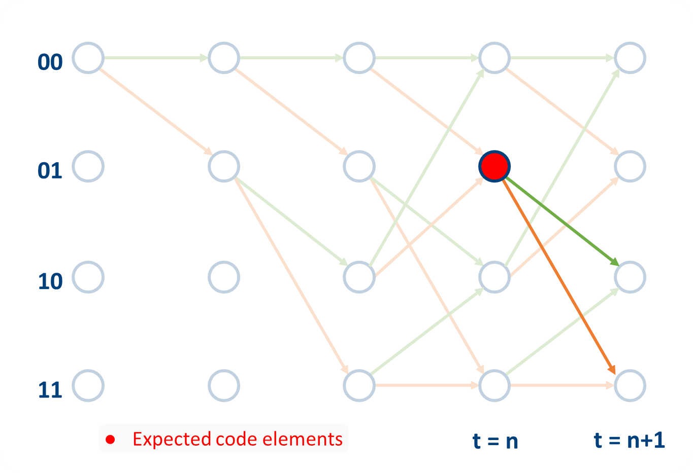


1
0
1
0
0
1
1
$$z^{−1}$$
$$z^{−1}$$
0
Branches
1st predicted code elements
2nd predicted code elements
0
1
0

Slide 191
0
1
1
1
0
1
1
$$z^{−1}$$
$$z^{−1}$$
0
Branches
1st predicted code elements
2nd predicted code elements
0
1
1
1
0

Slide 192
10
01
Branches
1st predicted code elements
2nd predicted code elements
0
1
1
0
0
1

Slide 193
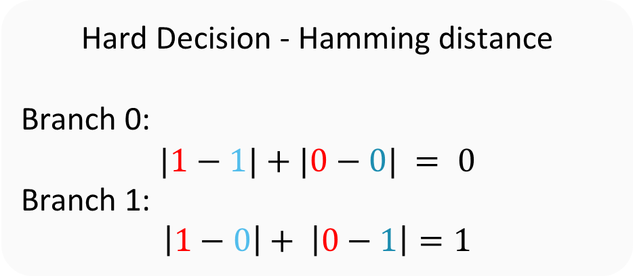
Branches
1st predicted code elements
2nd predicted code elements
0
1
10
1
0
01
0
1
Assumption
Input:
1
0
Hard Decision - Hamming distance
Branch 0:
$$|1−1|+|0−0| = 0$$
Branch 1:
$$\left|1−0\right|+ \left|0−1\right|=1$$

Slide 194
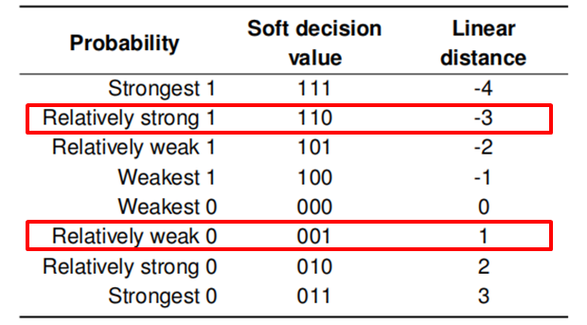
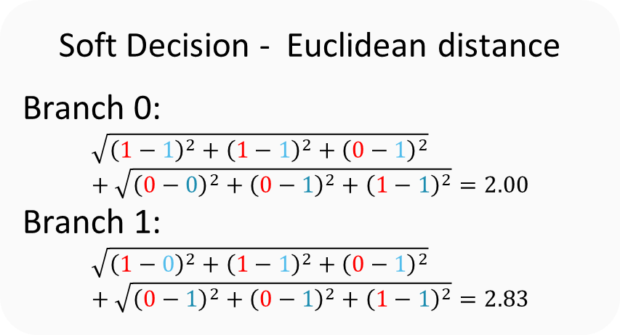
Branches
1st predicted code elements
2nd predicted code elements
0
1
10
111
011
1
0
01
0
1
011
111
Assumption
Input:
110
(relatively strong 1)
001
(relatively weak 0)
Soft Decision - Euclidean distance
Branch 0:
$$\sqrt{{\left(1−1\right)}^{2}+{\left(1−1\right)}^{2}+{\left(0−1\right)}^{2}}+\sqrt{{\left(0−0\right)}^{2}+{\left(0−1\right)}^{2}+{\left(1−1\right)}^{2}}=2.00$$
Branch 1:
$$\sqrt{{\left(1−0\right)}^{2}+{\left(1−1\right)}^{2}+{\left(0−1\right)}^{2}}+\sqrt{{\left(0−1\right)}^{2}+{\left(0−1\right)}^{2}+{\left(1−1\right)}^{2}}=2.83$$

Slide 195
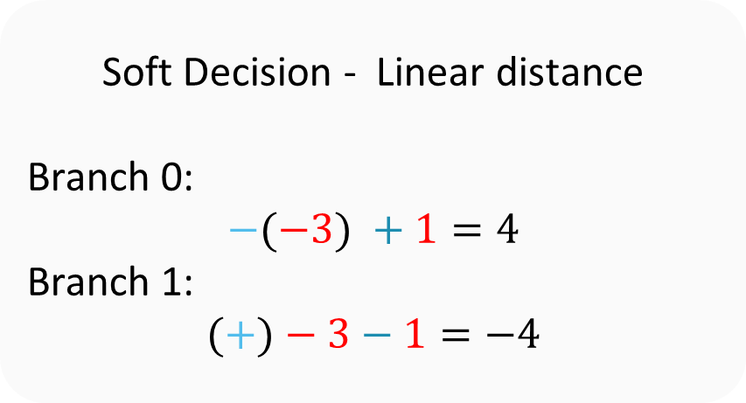
Branches
1st predicted code elements
2nd predicted code elements
0
1
10
1
0
01
0
1
Assumption
Input:
110
(relatively strong 1)
001
(relatively weak 0)
Soft Decision - Linear distance
Branch 0:
$$−(−3) +1=4$$
Branch 1:
$$(+)−3−1=−4$$
(-3)
(1)
●

Slide 196
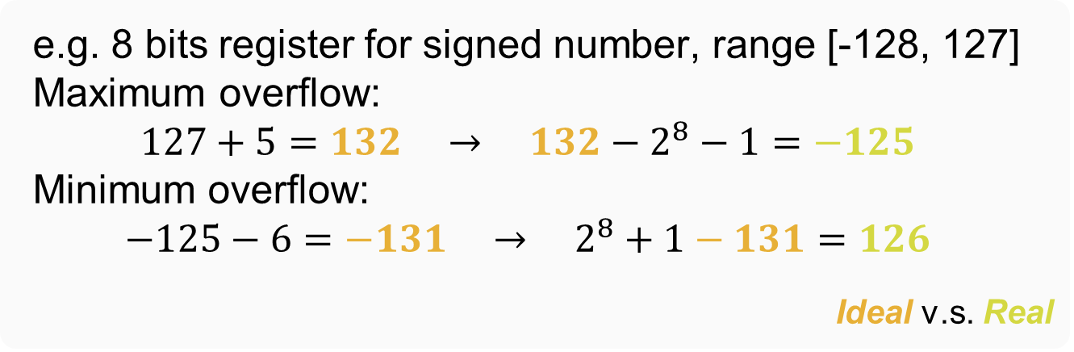
Overflow
an arithmetic operation attempts to create a numeric value that is outside of the range that can be represented with a given number of bits
e.g. 8 bits register for signed number, range [-128, 127]
Maximum overflow:
$$127+5=132 → 132−2^{8}−1=−125$$
Minimum overflow:
$$−125−6=−131 → 2^{8}+1−131=126$$
Ideal v.s. Real

Slide 197
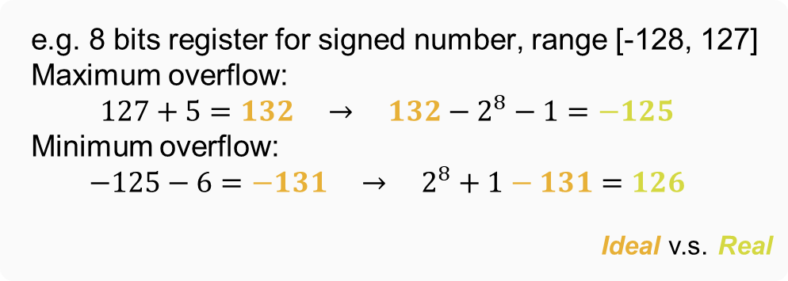
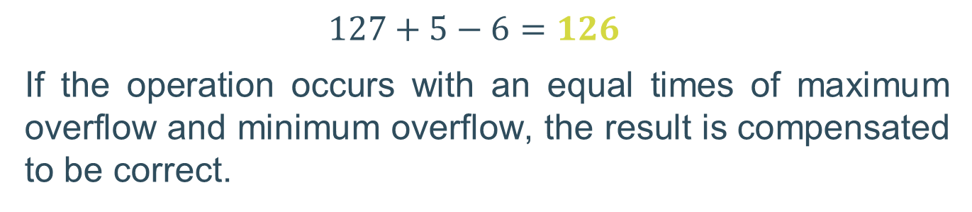
Overflow
e.g. 8 bits register for signed number, range [-128, 127]
Maximum overflow:
$$127+5=132 → 132−2^{8}−1=−125$$
Minimum overflow:
$$−125−6=−131 → 2^{8}+1−131=126$$
Ideal v.s. Real
$$127+5−6=126$$
If the operation occurs with an equal times of maximum overflow and minimum overflow, the result is compensated to be correct.

Slide 198
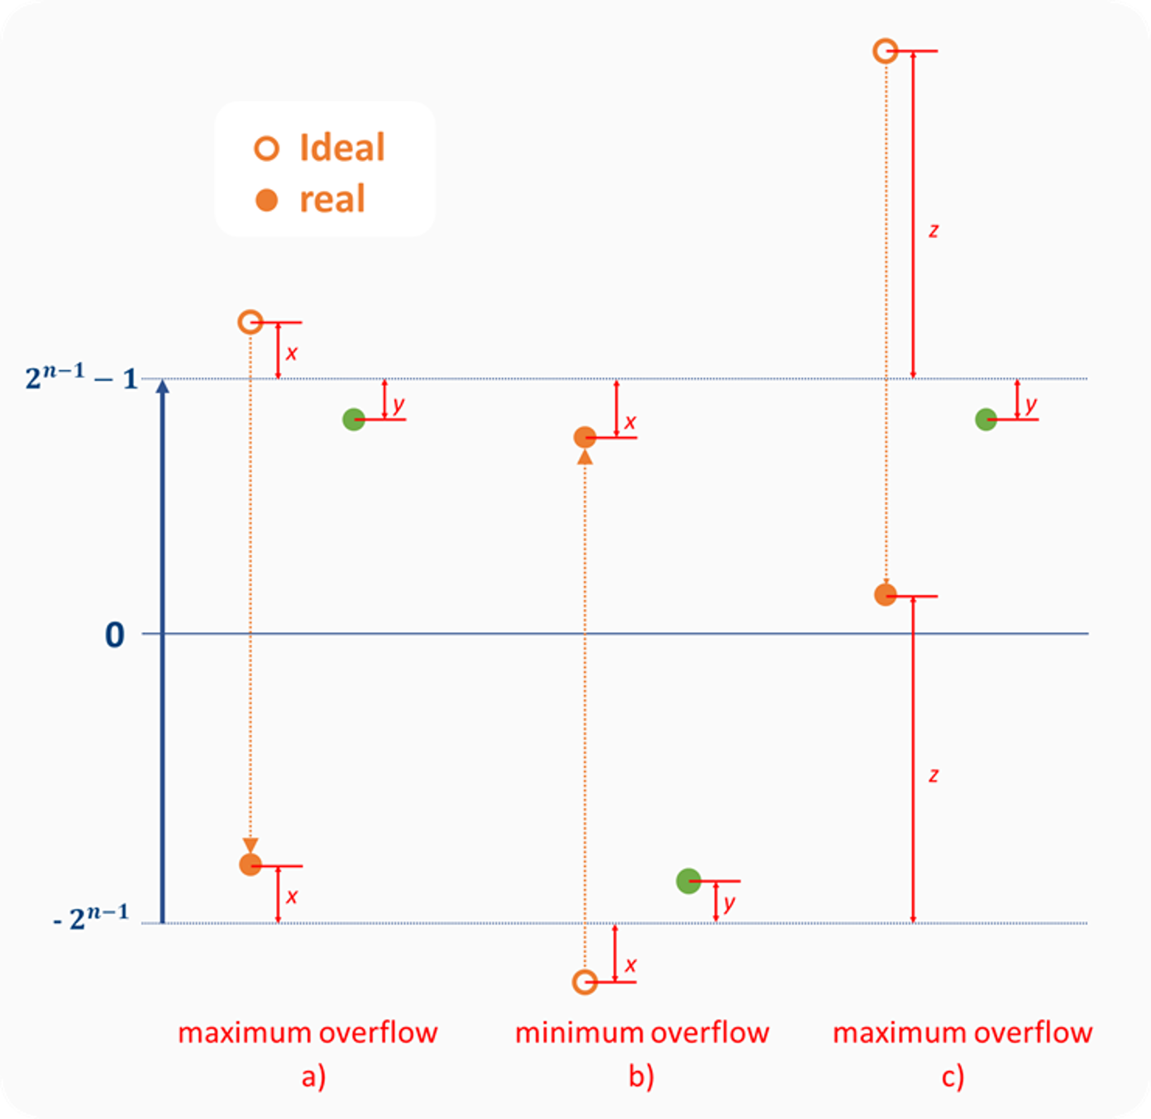
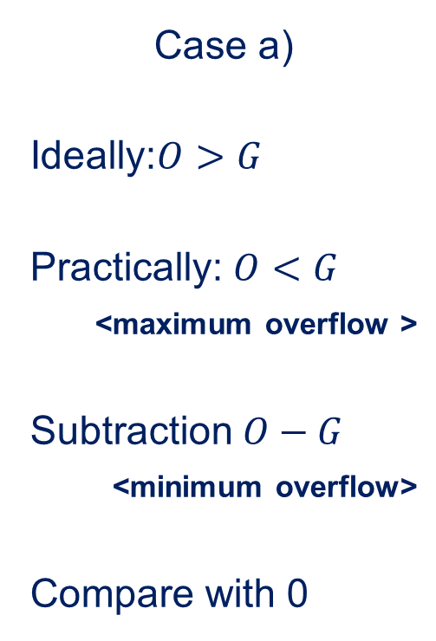
Normalization
n-bit register
Case a)
Ideally:$O>G$
Practically: $O<G$
<maximum overflow >
Subtraction $O−G$
<minimum overflow>
Compare with 0

Slide 199
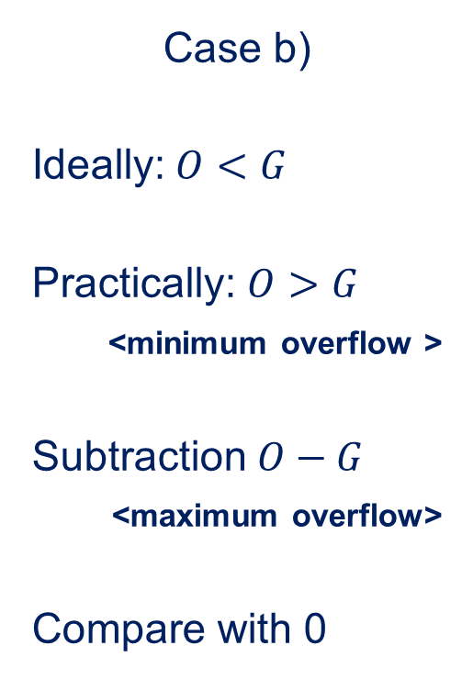
Normalization
n-bit register
Case b)
Ideally:$O<G$
Practically: $O>G$
<minimum overflow >
Subtraction $O−G$
<maximum overflow>
Compare with 0

Slide 200
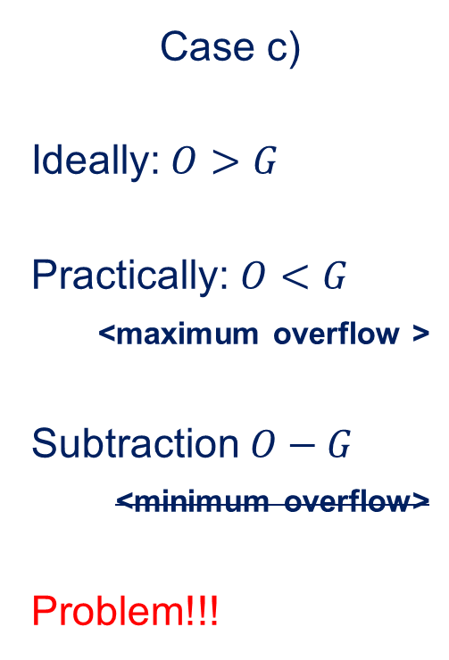
Normalization
n-bit register
Case c)
Ideally:$O>G$
Practically: $O<G$
<maximum overflow >
Subtraction $O−G$
<minimum overflow>
Problem!!!

Slide 201
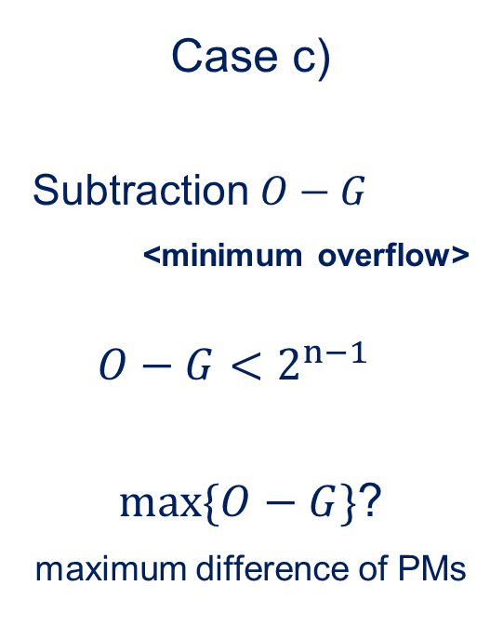
Normalization
n-bit register
Case c)
Subtraction $O−G$
<minimum overflow>
$$O−G<2^{n−1}$$
$max\{O−G\}$?
maximum difference of PMs

Slide 202


Normalization
maximum difference of PMs
$∆b$: the largest branch metrics difference
$K$: the number of constraint length

Slide 203


Normalization
${10}^{8}$ iterations
$$max\left\{O−G\right\}=2×∆b×K$$
$$∆b=14,K=7$$
$$max\left\{O−G\right\}=196<2^{n−1}$$
$n≥9$ → $n=9$
●

Slide 204
Overflow problem - ACSU

Slide 205

Overflow problem - Normalization

Slide 206
SMU structure
Register Exchange (RE)
Traceback (TB)
Write/Read the correct paths
Reflash all the registers when new input comes
Immediate output after receiving the last input
Write/Read the previous most/least significant bits
Only Update the latest register bits
Need time to trace the sequence

Slide 207
RE - writing
[
00
]
01
[
]
[
10
]
[
11
]
t = 1
t = 2

Slide 208
RE - writing
[
0
00
]
01
[
1
]
[
10
]
[
11
]
t = 1
t = 2

Slide 209
RE - writing
[
0
00
]
01
[
1
]
[
10
]
[
11
]
t = 1
t = 2

Slide 210
RE - writing
[
0
]
00
[
1
]
01
[
]
10
[
]
11
t = 1
t = 2
t = 3

Slide 211
RE - writing
[
0
]
[
0
]
00
[
1
]
[
1
]
01
[
]
10
[
]
11
t = 1
t = 2
t = 3

Slide 212
RE - writing
[
0
00
]
01
[
0
]
10
[
1
]
[
1
11
]
t = 1
t = 2
t = 3

Slide 213
RE - writing
[
0
00
]
01
[
0
]
10
[
1
]
[
1
11
]
t = 1
t = 2
t = 3

Slide 214
RE - writing
[
0
0
00
]
01
[
0
1
]
10
[
1
0
]
[
1
1
11
]
t = 1
t = 2
t = 3

Slide 215
RE - writing
[
0
0
00
]
01
[
0
1
]
10
[
1
0
]
[
1
1
11
]
t = 1
t = 2
t = 3

Slide 216
RE - writing
[
0
0
]
00
[
0
1
]
01
[
1
0
]
10
[
1
1
]
11
t = 1
t = 2
t = 3
t = 4

Slide 217
RE - writing
[
0
0
]
00
[
0
1
]
01
[
1
0
]
[
1
0
]
10
[
1
1
]
[
1
1
]
11
t = 1
t = 2
t = 3
t = 4

Slide 218
RE - writing
[
1
0
00
]
[
1
0
01
]
[
1
1
10
]
[
1
1
11
]
t = 1
t = 2
t = 3
t = 4

Slide 219
RE - writing
[
1
0
00
]
[
1
0
01
]
[
1
1
10
]
[
1
1
11
]
t = 1
t = 2
t = 3
t = 4

Slide 220
RE - writing
[
1
0
0
00
]
[
1
0
1
01
]
[
1
1
0
10
]
[
1
1
1
11
]
t = 1
t = 2
t = 3
t = 4

Slide 221
RE - writing
[
1
0
0
00
]
[
1
0
1
01
]
[
1
1
0
10
]
[
1
1
1
11
]
t = 1
t = 2
t = 3
t = 4

Slide 222
RE - writing
[
1
0
0
]
00
[
1
0
1
]
01
[
1
1
0
]
10
[
1
1
1
]
11
t = 1
t = 2
t = 3
t = 4
t = 5

Slide 223
RE - writing
[
1
0
0
]
00
[
1
0
1
]
01
[
1
1
0
[
]
1
1
0
]
10
[
1
1
1
]
11
t = 1
t = 2
t = 3
t = 4
t = 5

Slide 224
RE - writing
00
[
1
1
0
]
[
1
1
0
01
]
[
1
0
1
10
]
[
1
1
1
11
]
t = 1
t = 2
t = 3
t = 4
t = 5

Slide 225
RE - writing
00
[
1
1
0
]
[
1
1
0
01
]
[
1
0
1
10
]
[
1
1
1
11
]
t = 1
t = 2
t = 3
t = 4
t = 5

Slide 226
RE - writing
00
[
1
1
0
0
]
[
1
1
0
1
01
]
[
1
0
1
0
10
]
[
1
1
1
1
11
]
t = 1
t = 2
t = 3
t = 4
t = 5

Slide 227
RE - writing
00
[
1
1
0
0
]
[
1
1
0
1
01
]
[
1
0
1
0
10
]
[
1
1
1
1
11
]
t = 1
t = 2
t = 3
t = 4
t = 5

Slide 228
RE - writing
[
1
1
0
0
[
]
1
1
0
0
]
00
[
1
1
0
1
]
01
[
1
0
1
0
]
10
[
1
1
1
1
]
11
t = 1
t = 2
t = 3
t = 4
t = 5
t = 6

Slide 229
RE - writing
00
[
1
1
0
0
]
[
1
1
0
0
01
]
[
1
1
1
1
10
]
[
1
1
0
1
11
]
t = 1
t = 2
t = 3
t = 4
t = 5
t = 6

Slide 230
RE - writing
00
[
1
1
0
0
]
[
1
1
0
0
01
]
[
1
1
1
1
10
]
[
1
1
0
1
11
]
t = 1
t = 2
t = 3
t = 4
t = 5
t = 6

Slide 231
RE - writing
00
[
1
1
0
0
0
]
[
1
1
0
0
1
01
]
[
1
1
1
1
0
10
]
[
1
1
0
1
1
11
]
t = 1
t = 2
t = 3
t = 4
t = 5
t = 6

Slide 232
RE - reading
00
[
1
1
0
0
0
]
[
1
1
0
0
1
01
]
[
1
1
1
1
0
10
]
[
12
11
05
13
14
11
]
t = 1
t = 2
t = 3
t = 4
t = 5
t = 6

Slide 233
RE - reading
Decoded
12
11
05
13
14
First
Last
●

Slide 234

Multiple threads traceback
Acquisition significantly influences the decoding accuracy (BER) compared to Windows
Mohammadidoost and Hashemi (2020)

Slide 235

Multiple threads traceback
Acquisition significantly influences the decoding accuracy (BER) compared to Windows
Mohammadidoost and Hashemi (2020)
$$Delay≈( ACQ+WIN )×2$$

Slide 236

Multiple threads traceback
$$Delay≈( ACQ+WIN )×2$$

Slide 237




Multiple threads traceback
Compare with $t=2$
Delay:
$$\frac{2+t}{2t} (t>2)$$
Memory:
$$\frac{t}{2} (t>2)$$
Best choice: $t=2$
●

Slide 238



ACQ & WIN length selection
$$v_{2}: ACQ$$
$$f_{0}: WIN$$
Mohammadidoost and Hashemi (2020)
It is recommended to be at least six times the number of constraint length ($K=7$) to ensure the acquisition has enough samples to converge to the correct values
$$ACQ=50, WIN=55$$
●

Slide 239
Environment
Run the Tcl script that builds the OpenWiFi project
Communicate with the FPGA
Ubuntu OS 18.04
Xilinx Vivado 2018.3
MATLAB R2022a
FPGA ZedBoard
Design
Simulation
Synthesis
Check bit error rate by output file
Add AWGN to input file to check noise resilience
On-board prototyping
●

Slide 240


BER test files
●

Slide 241

Max clock frequency
●

Slide 242



Validation on the board
Device View
Ported one
Xilinx one
Utilization report in the implementation step (verified on the ZedBoard)
●

Slide 243
Advanced algorithms
Forward Traceback Method (Zhao et al., 2017)
combined the backward (TB) and forward (RE) methods together
The target started traceback state was obtained by forwarding recursive computing, which meant the acquisition phase was no longer needed.
Compared with TB, such a structure reduced delay by 25%. Furthermore, the storage space (shift registers) paid in this way was far less than RE.

Slide 244
Advanced algorithms
T-algorithm (Surya et al., 2021)
generates a threshold value and removes the redundant states from the ACSU for the next cycle
The area and power consumption are reduced by 20.90% and 18.18%
●

Slide 245
Xilinx Viterbi Decoder v7.0
High-speed, compact
Constraint lengths 3 - 9
TB structure
External de-punching (code rates 1/2 - 1/7)
●

